Slide 1

Kako biti “igrač” u
Cloud igri
Otkrijte snagu AWS optimizacije troškova u svrhu unapredjenja poslovanja
@ JavaCro23
Utorak 17. Oktobar 2023.
Hotel Istra - Rovinj/Hrvatska

Slide 2
Elevate the
Cloud Game
Unveil the power of AWS Cost Optimisation for business growth
@ JavaCro23
Tuesday October 15th 2023.
Hotel Istra - Rovinj/Croatia

Slide 3

“Elevate The Cloud Game” - Stoisavljević Aleksandar @ 2023

Slide 4

“Elevate The Cloud Game” - Stoisavljević Aleksandar @ 2023

Slide 5

June 14th 2012.
“Elevate The Cloud Game” - Stoisavljević Aleksandar @ 2023

Slide 6


“Elevate The Cloud Game” - Stoisavljević Aleksandar @ 2023

Slide 7

“Elevate The Cloud Game” - Stoisavljević Aleksandar @ 2023

Slide 8


“Elevate The Cloud Game” - Stoisavljević Aleksandar @ 2023

Slide 9
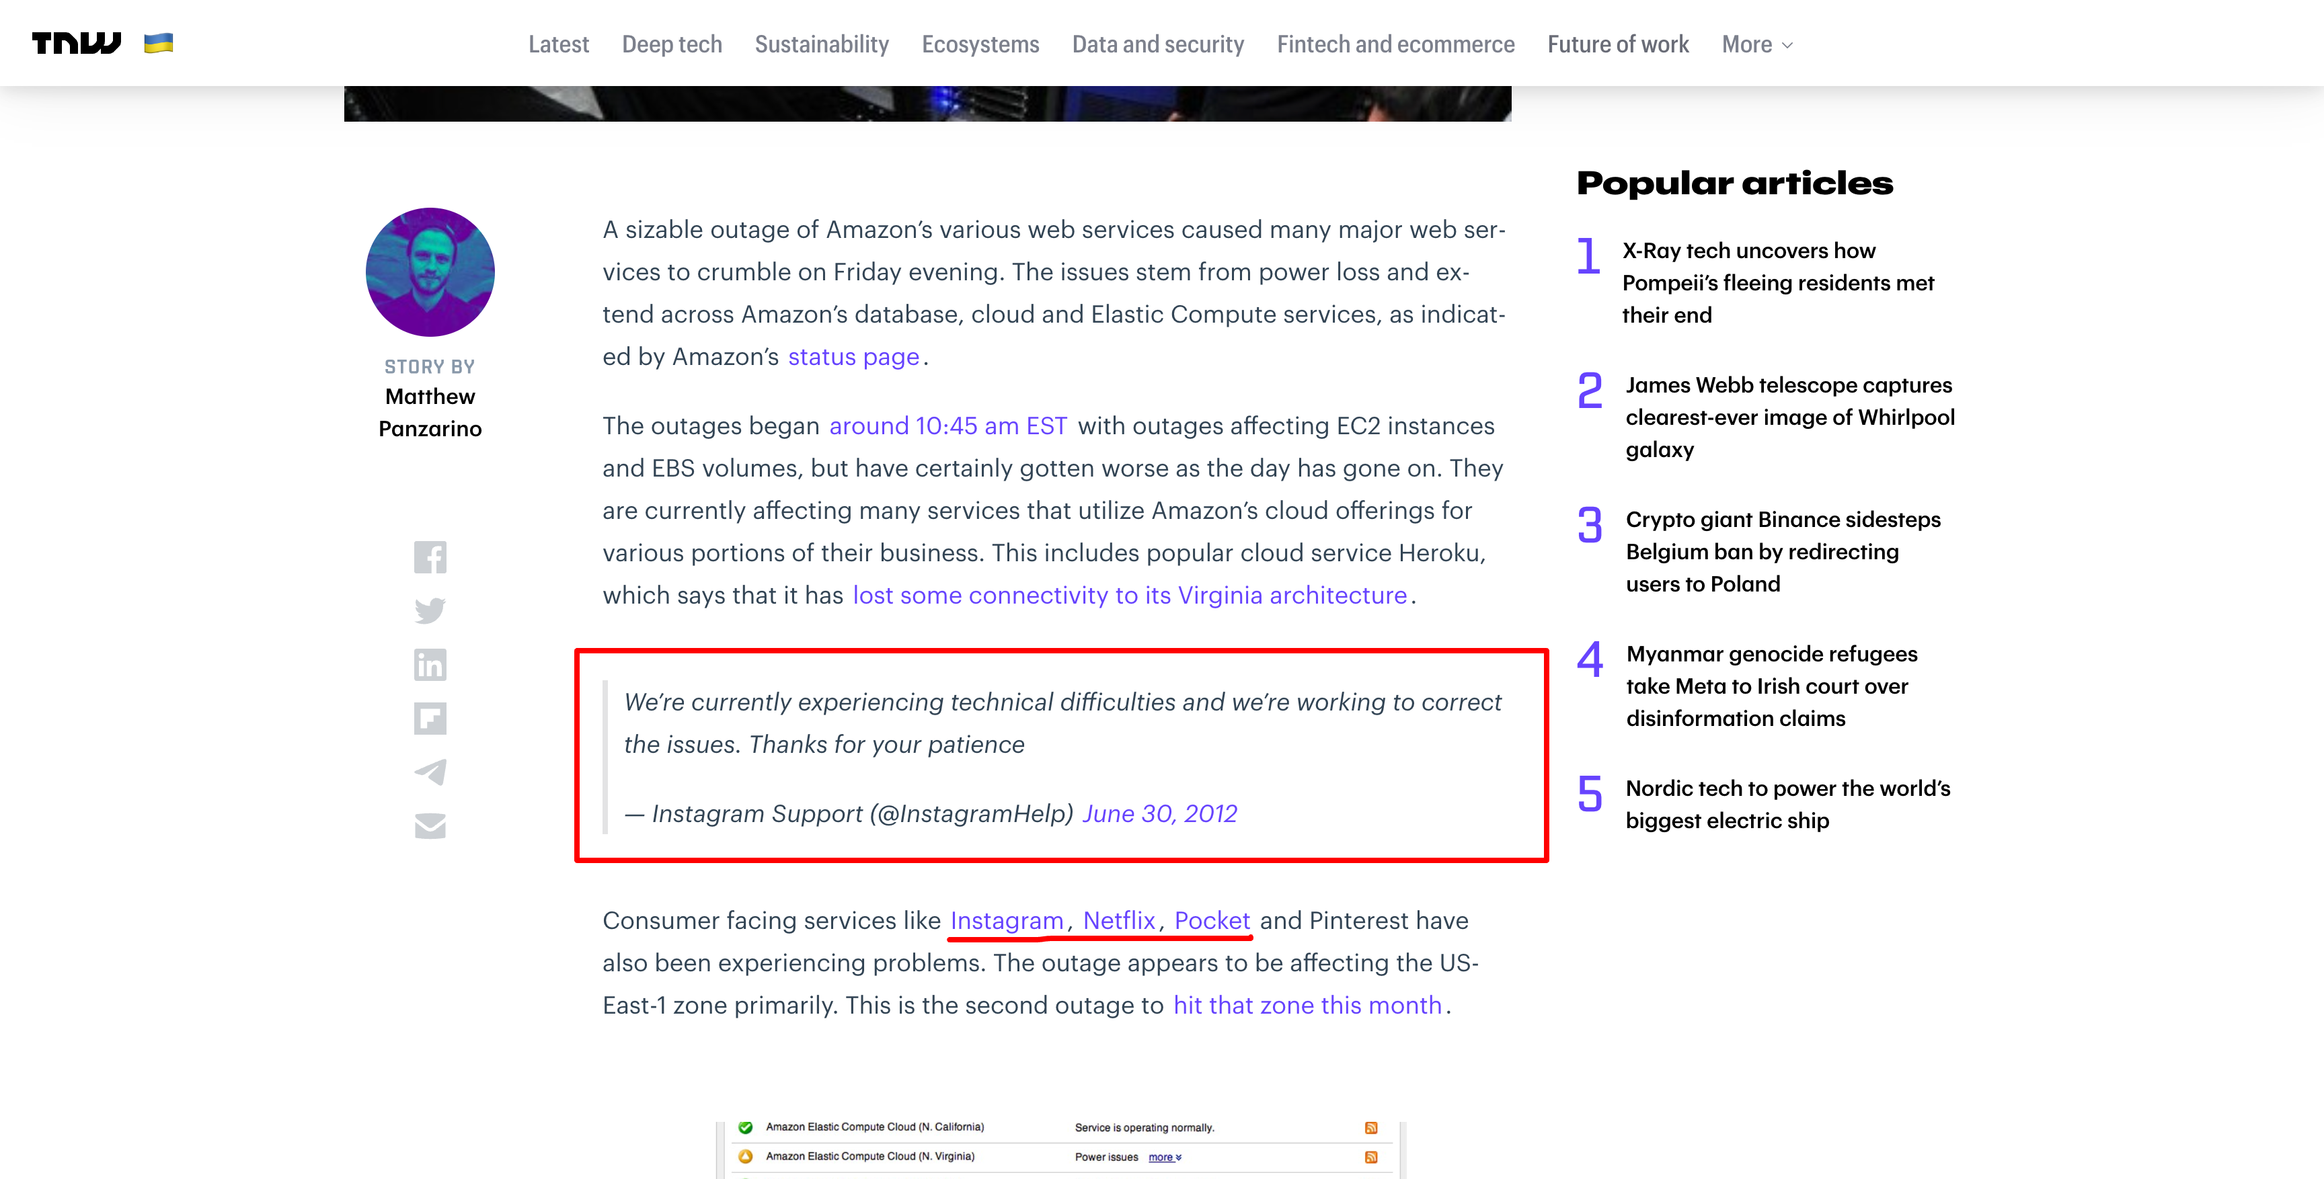
“Elevate The Cloud Game” - Stoisavljević Aleksandar @ 2023

Slide 10
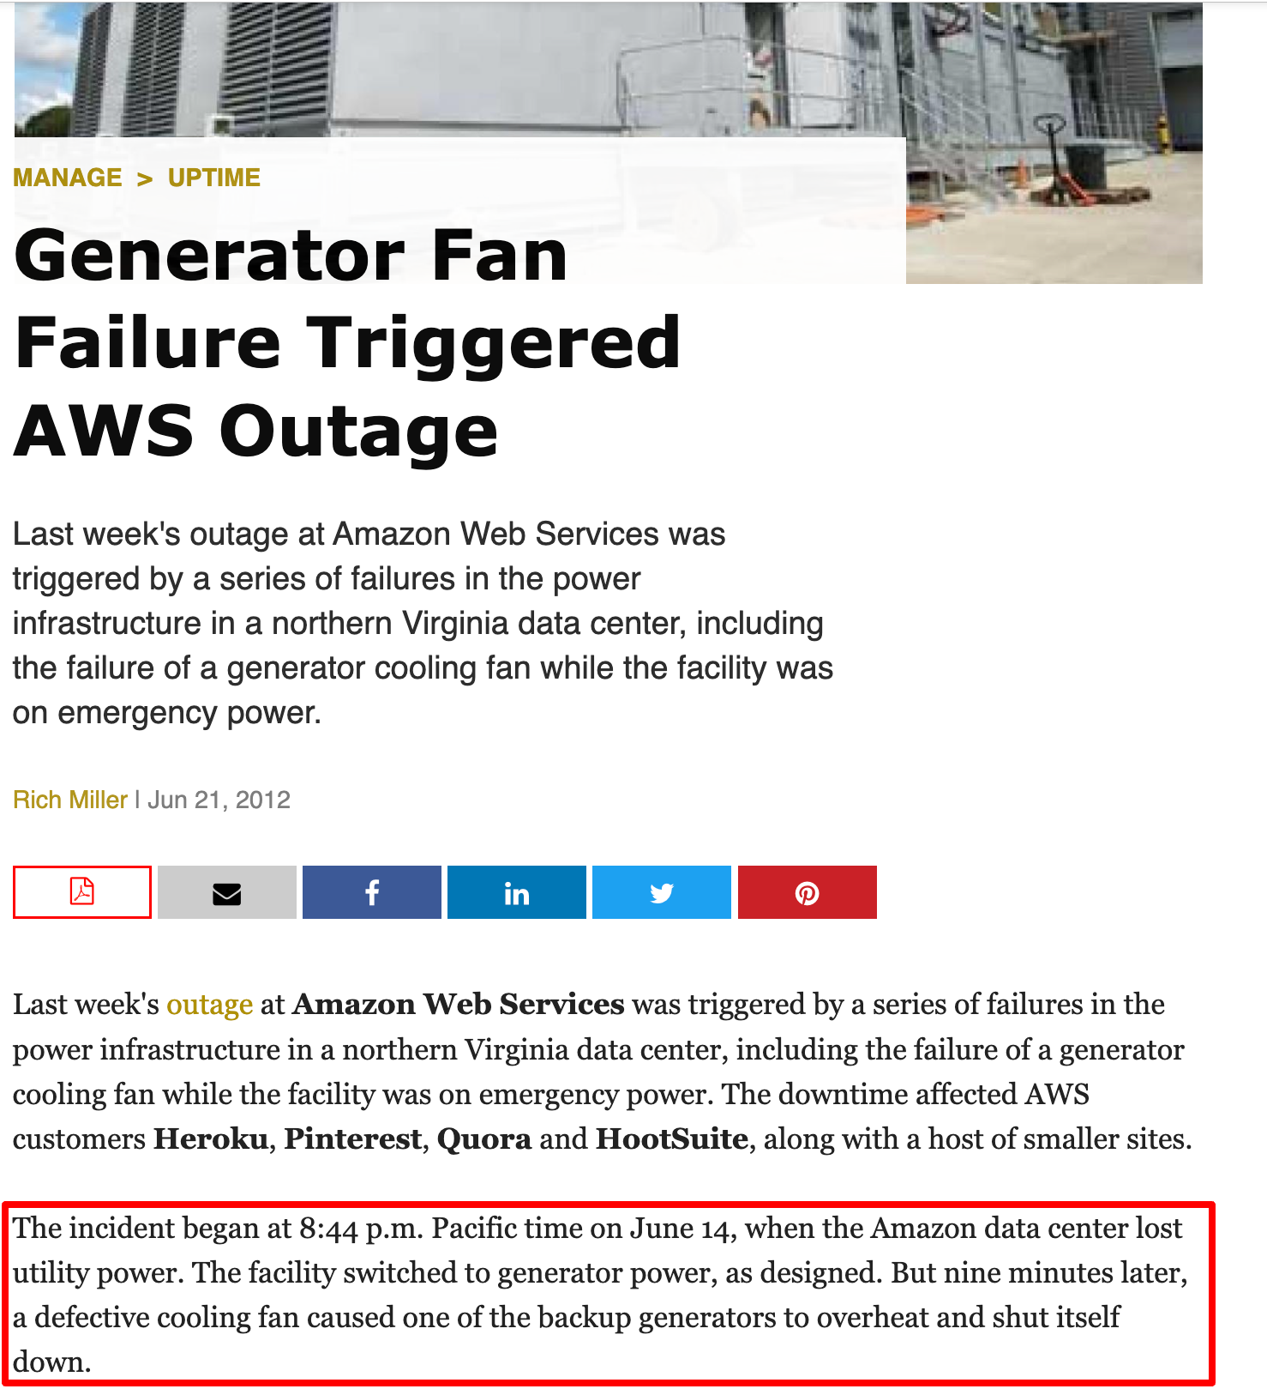
“Elevate The Cloud Game” - Stoisavljević Aleksandar @ 2023

Slide 11
Netflix, Instagram, Pinterest, …
… but some weren’t affected? How come?
“Elevate The Cloud Game” - Stoisavljević Aleksandar @ 2023

Slide 12





Aleksandar Stoisavljević
it consultant @NovaCode
Accomplished individual with a strong background in Java (20+ yrs in IT business). Goal oriented, analytical and sharp individual with a lot of energy. Strong will to spread inspiration among his co-workers. Coming from city of Novi Sad, one of the biggest IT centres in Serbia, Aleksandar has been working in various environments. Professional career started as desktop developer (Delphi IDE) and joined one international company in 2007. with its headquarters in Amsterdam. Primary focus were various kinds of server-side systems and web applications. As from 2015. actively learning and helping clients to prepare and adopt for the Cloud. In 2017. Joined Jatheon where he works nowadays as Software Architect & Director of Engineering (DoE). In the “off-working hours” father of two. Like to play table tennis.
astoisavljevic
@staleksit

Slide 13
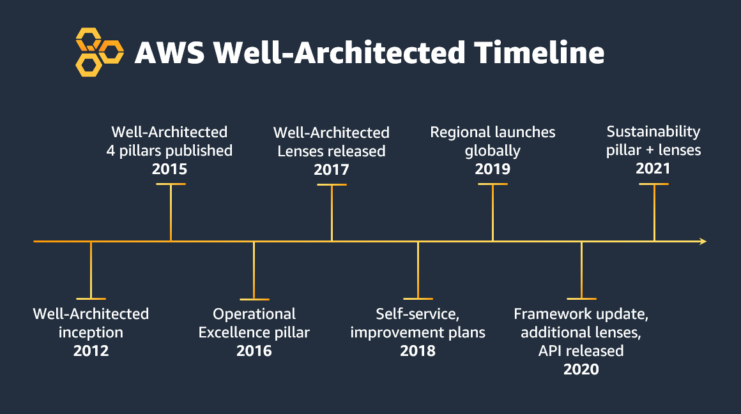
AWS Well-Architected Framework
“Elevate The Cloud Game” - Stoisavljević Aleksandar @ 2023

Slide 14
AWS Well-Architected Framework
1. Reliability
2. Security
3. Performance Efficiency
4. Cost Optimization
5. Operational Excellence
6. Sustainability
URL: https://aws.amazon.com/architecture/well-architected/
“Elevate The Cloud Game” - Stoisavljević Aleksandar @ 2023

Slide 15

Cost Optimization
“Elevate The Cloud Game” - Stoisavljević Aleksandar @ 2023
Caption

Slide 16
Cost Optimization
1. Implement cloud financial management
2. Adopt a consumption model
3. Measure overall efficiency
4. Analyse and attribute expenditure
5. Stop spending money on undifferentiated heavy lifting
“Elevate The Cloud Game” - Stoisavljević Aleksandar @ 2023
Notes:
11.10.2023. - revisit

Slide 17




Design Principles
Implement cloud financial management
Cloud Financial
Management
Cloud Financial Management (CFM) - allows finance, product, technology, and business organizations to manage, optimize, and plan costs as they grow their usage and scale on AWS. The primary goal of CFM is to allow customers to achieve their business outcomes in the most cost-efficient manner and accelerate economic and business value creation while finding the right balance between agility and control.
See
Save
Plan
Run
“Elevate The Cloud Game” - Stoisavljević Aleksandar @ 2023

Slide 18
Design Principles
CFM Best Practices (items: 9)
COST01 - BP01 - Establish a cost optimization function
Cloud Financial
Management
COST01 - BP02 - Establish a partnership between finance and technology
COST01
BP03
COST01
BP04
COST01 - BP03 - Establish cloud budgets and forecasts
COST01
BP02
COST01
BP05
COST01 - BP04 - Implement cost awareness
in your organisational processes
COST01
BP01
CFM
Best Practices
COST01 - BP05 - Report and notify on cost
optimisation
COST01
BP06
COST01 - BP06 - Monitor cost proactively
COST01
BP09
COST01
BP07
COST01 - BP07 - Keep up-to-date with new service releases
COST01
BP08
COST01 - BP08 - Create a cost aware culture
COST01 - BP09 - Quantify business value from cost optimisation
“Elevate The Cloud Game” - Stoisavljević Aleksandar @ 2023

Slide 19
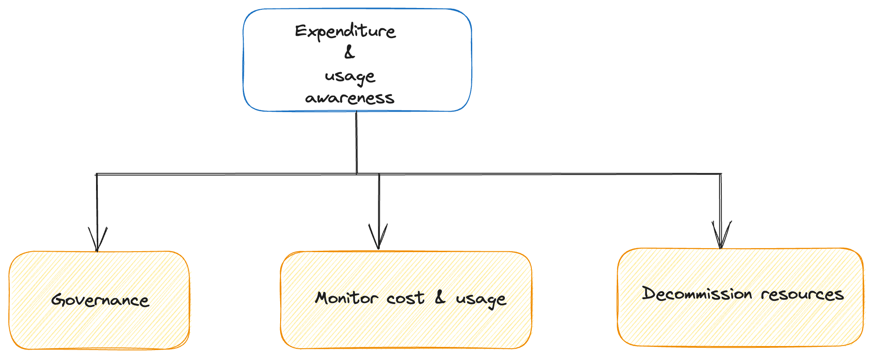
Design Principles
Cloud Financial
Management
Expenditure and usage awareness
“Elevate The Cloud Game” - Stoisavljević Aleksandar @ 2023

Slide 20
Design Principles
Governance (items: 6)
COST02 - BP01 - Develop policies based on your
organisation requirements
Cloud Financial
Management
COST02 - BP02 - Implement goals and targets
COST02
BP02
COST02
BP03
Expenditure and usage awareness
COST02 - BP03 - Implement an
account structure
COST02
BP01
Governance
Best Practices
COST02
BP04
COST02 - BP04 - Implement groups and roles
COST02 - BP05 - Implement cost controls
COST02
BP06
COST02
BP05
COST02 - BP06 - Track project lifecycle
“Elevate The Cloud Game” - Stoisavljević Aleksandar @ 2023

Slide 21
Design Principles
Monitor cost and usage (items: 6)
Cloud Financial
Management
COST03 - BP01 - Configure detailed
information sources
COST03 - BP02 - Add organization information
to cost and usage
COST03
BP02
COST03
BP03
Expenditure and usage awareness
COST03 - BP03 - Identify cost attribution
categories
Monitor Cost
&
Usage
Best Practices
COST03
BP01
COST03
BP04
COST03 - BP04 - Establish organization
Metrics
COST03 - BP05 - Configure billing and cost
management tools
COST03
BP06
COST03
BP05
COST03 - BP06 - Allocate cost based
on workload metrics
“Elevate The Cloud Game” - Stoisavljević Aleksandar @ 2023

Slide 22
Design Principles
Decommission resources (items: 5)
Cloud Financial
Management
COST04 - BP01 - Track resources over
their lifetime
COST04
BP02
COST04
BP03
COST04 - BP02 - Implement decommission
process
Expenditure and usage awareness
COST04 - BP03 - Decommission resources
Decommission
Best Practices
COST04 - BP04 - Decommission resources
automatically
COST04
BP01
COST04
BP04
COST04 - BP05 - Enforce data retention
policies
COST04
BP05
“Elevate The Cloud Game” - Stoisavljević Aleksandar @ 2023

Slide 23
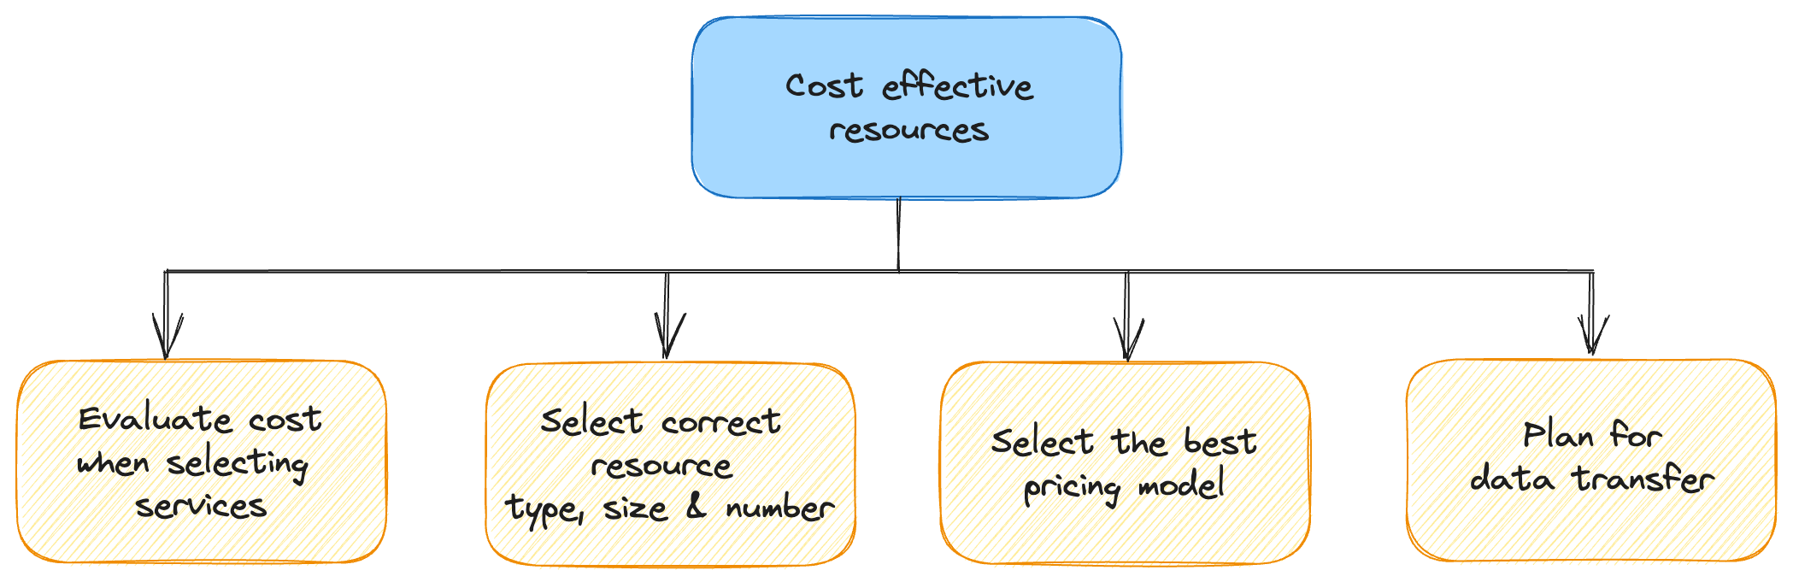
Design Principles
Cloud Financial
Management
Expenditure and usage awareness
Cost effective resources
“Elevate The Cloud Game” - Stoisavljević Aleksandar @ 2023

Slide 24
Design Principles
Evaluate cost when selecting services (items: 6)
COST05 - BP01 - Identify organization
requirements for cost
Cloud Financial
Management
COST05
BP02
COST05
BP03
COST05 - BP02 - Analyse all components
of the workload
Expenditure and usage awareness
COST05 - BP03 - Perform a throughout
analysis of each component
Evaluate Cost
Best Practices
COST05
BP01
COST05
BP04
COST05 - BP04 - Select software with
cost-effect licensing
COST05 - BP05 - Select components of
this workload to optimise cost in line with
org. priorities
COST05
BP06
COST05
BP05
COST05 - BP06 - Perform cost analysis
for different usage over time
“Elevate The Cloud Game” - Stoisavljević Aleksandar @ 2023

Slide 25
Design Principles
Select the correct resource type, size and number (items: 3)
COST06 - BP01 - Perform cost
modelling
Cloud Financial
Management
COST06
BP02
COST06 - BP02 - Select resource type, size
and number based on data
Expenditure and usage awareness
COST06 - BP03 - Select resource type, size
and number automatically based on metrics
Resources, Size, Number
Best Practices
Cost effective resources
COST06
BP01
COST06
BP03
“Elevate The Cloud Game” - Stoisavljević Aleksandar @ 2023

Slide 26
Design Principles
Select the best pricing model (items: 5)
COST07 - BP01 - Perform pricing model
analysis
Cloud Financial
Management
COST07 - BP02 - Implement regions
based on cost
COST07
BP02
COST07
BP03
Expenditure and usage awareness
COST07 - BP03 - Select third-party
agreements with cost-efficient terms
Pricing Model
Best Practices
Cost effective resources
COST07 - BP04 - Implement pricing models
for all the components of this
workload
COST07
BP01
COST07
BP04
COST07 - BP05 - Perform pricing model
analysis at the management
account level
COST07
BP05
“Elevate The Cloud Game” - Stoisavljević Aleksandar @ 2023

Slide 27
Design Principles
Plan for data transfer (items: 3)
COST08 - BP01 - Perform data transfer
modelling
Cloud Financial
Management
COST08
BP02
COST08 - BP02 - Select components to
optimize data transfer cost
Expenditure and usage awareness
COST08 - BP03 - Implement services
to reduce data transfer cost
Data Transfer
Best Practices
Cost effective resources
COST08
BP01
COST08
BP03
“Elevate The Cloud Game” - Stoisavljević Aleksandar @ 2023

Slide 28
Design Principles
Manage demand and supply resources (items: 3)
Cloud Financial
Management
COST09 - BP01 - Perform an analysis on
the workload demand
COST09
BP02
COST09 - BP02 - Implement a buffer
or throttle to manage demand
Expenditure and usage awareness
COST09 - BP03 - Supply resources
dynamically
Manage Demand
& Supply Resources
Best Practices
Cost effective resources
COST09
BP01
Manage demand & supplying resources
COST09
BP03
“Elevate The Cloud Game” - Stoisavljević Aleksandar @ 2023

Slide 29
Design Principles
Define a review process and analyze your workload regularly (items: 2)
Cloud Financial
Management
COST10 - BP01 - Develop a workload
review process
Expenditure and usage awareness
COST10 - BP02 - Review and analyze
this workload regularly
Review Workflow
& Analyse
Best Practices
Cost effective resources
COST10
BP01
Manage demand & supplying resources
COST10
BP02
Optimize over time
“Elevate The Cloud Game” - Stoisavljević Aleksandar @ 2023

Slide 30
Design Principles
Automating operations (items: 1)
Cloud Financial
Management
COST11 - BP01 - Perform automations
for operations
Expenditure and usage awareness
Automation
Best Practices
Cost effective resources
COST11
BP01
Manage demand & supplying resources
Optimize over time
“Elevate The Cloud Game” - Stoisavljević Aleksandar @ 2023

Slide 31
Jatheon
Data archiving solutions for compliance and legal support
“Elevate The Cloud Game” - Stoisavljević Aleksandar @ 2023

Slide 32
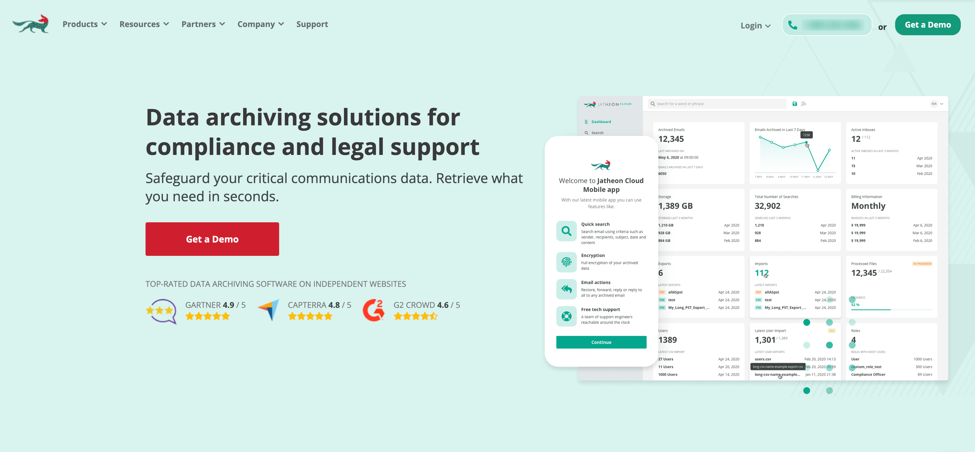
“Elevate The Cloud Game” - Stoisavljević Aleksandar @ 2023

Slide 33

Archiving is like having a digital paper
trail of your organisation’s history,
making it invaluable for compliance and
record-keeping.
“
“Elevate The Cloud Game” - Stoisavljević Aleksandar @ 2023
Notes:
Data Archiving Benefits:
https://jatheon.com/blog/data-archiving-benefits

Slide 34






Sarbanes - Oxley (SOX)
Compliance
Act
Securities and Exchange
Commission (SEC)
Compliance
Commodity Futures
Trading Commission (CFTC)
Compliance
Health Insurance Portability
And Accountability (HIPAA)
Compliance
Family Educational Rights
and Privacy (FERPA)
Act
New York State Cyber
SHIELD
Act
Notes:
SOX compliance is an annual obligation derived from the Sarbanes-Oxley Act (SOX) that requires publicly traded companies doing business in the U.S. to establish financial reporting standards, including safeguarding data, tracking attempted breaches, logging electronic records for auditing, and proving compliance.

Slide 35

“Elevate The Cloud Game” - Stoisavljević Aleksandar @ 2023

Slide 36
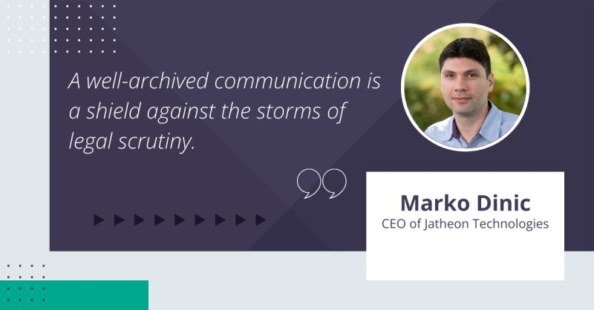
“Elevate The Cloud Game” - Stoisavljević Aleksandar @ 2023

Slide 37
ErgoCloud
Admin UI
“Elevate The Cloud Game” - Stoisavljević Aleksandar @ 2023

Slide 38
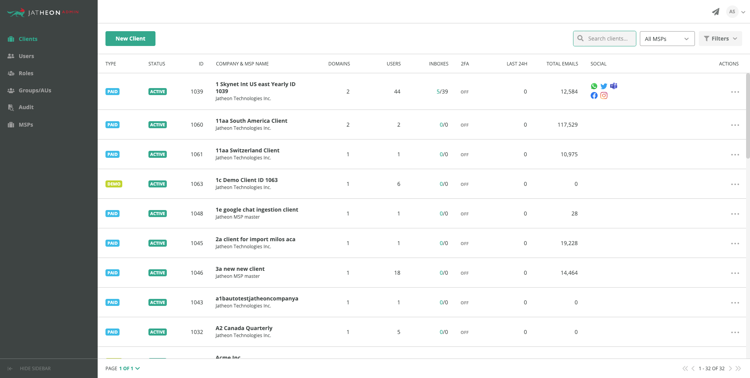
“Elevate The Cloud Game” - Stoisavljević Aleksandar @ 2023

Slide 39
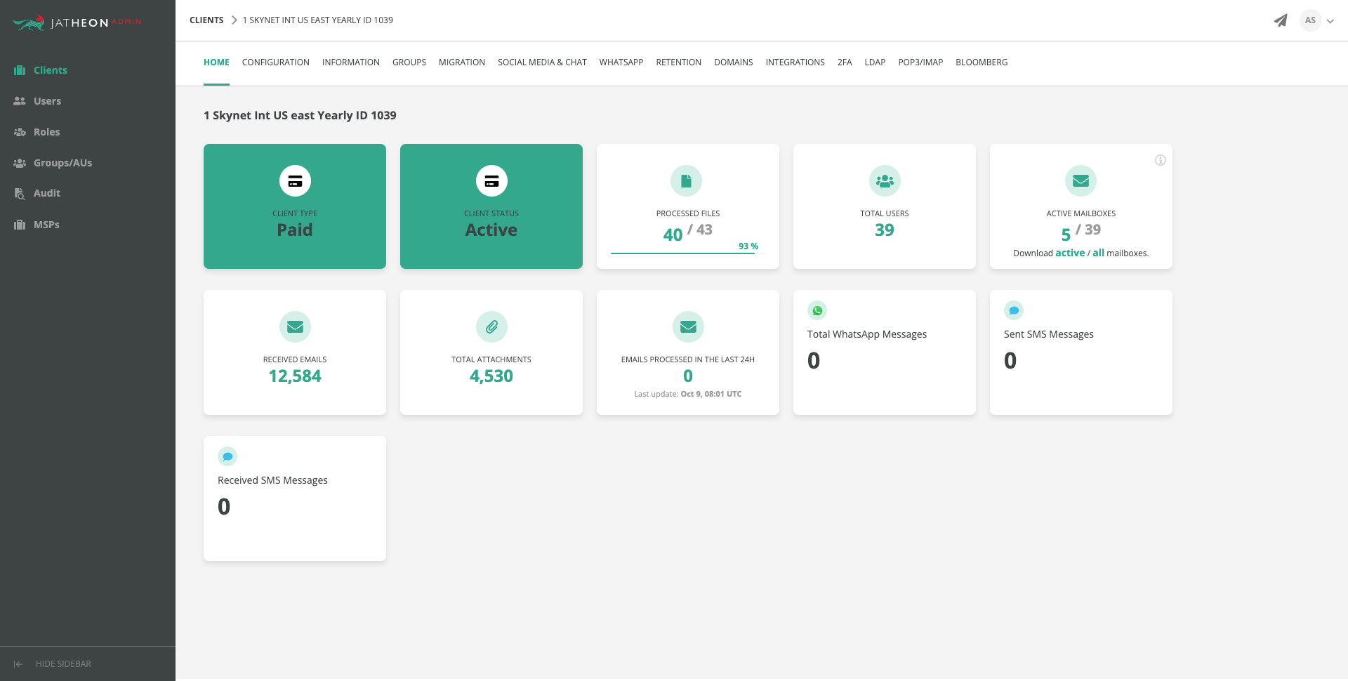
“Elevate The Cloud Game” - Stoisavljević Aleksandar @ 2023

Slide 40
ErgoCloud
Customer UI
“Elevate The Cloud Game” - Stoisavljević Aleksandar @ 2023

Slide 41
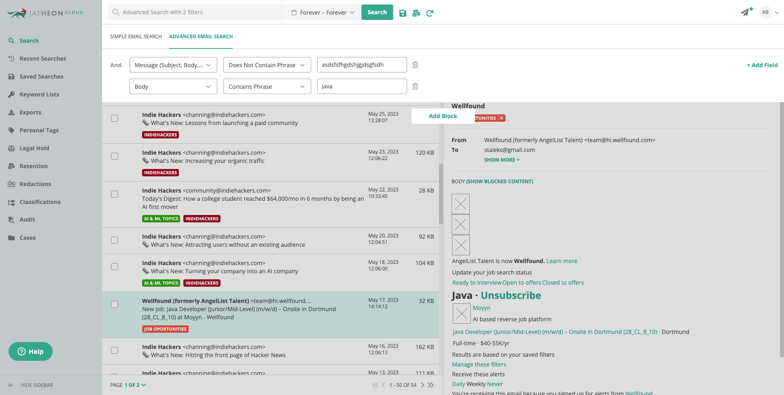
“Elevate The Cloud Game” - Stoisavljević Aleksandar @ 2023

Slide 42
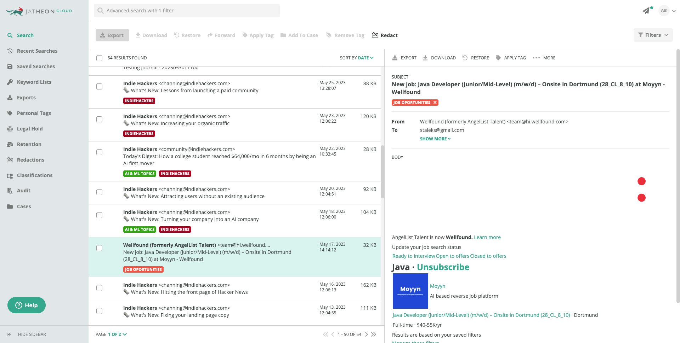
“Elevate The Cloud Game” - Stoisavljević Aleksandar @ 2023

Slide 43

ErgoCloud
Architecture
“Elevate The Cloud Game” - Stoisavljević Aleksandar @ 2023

Slide 44
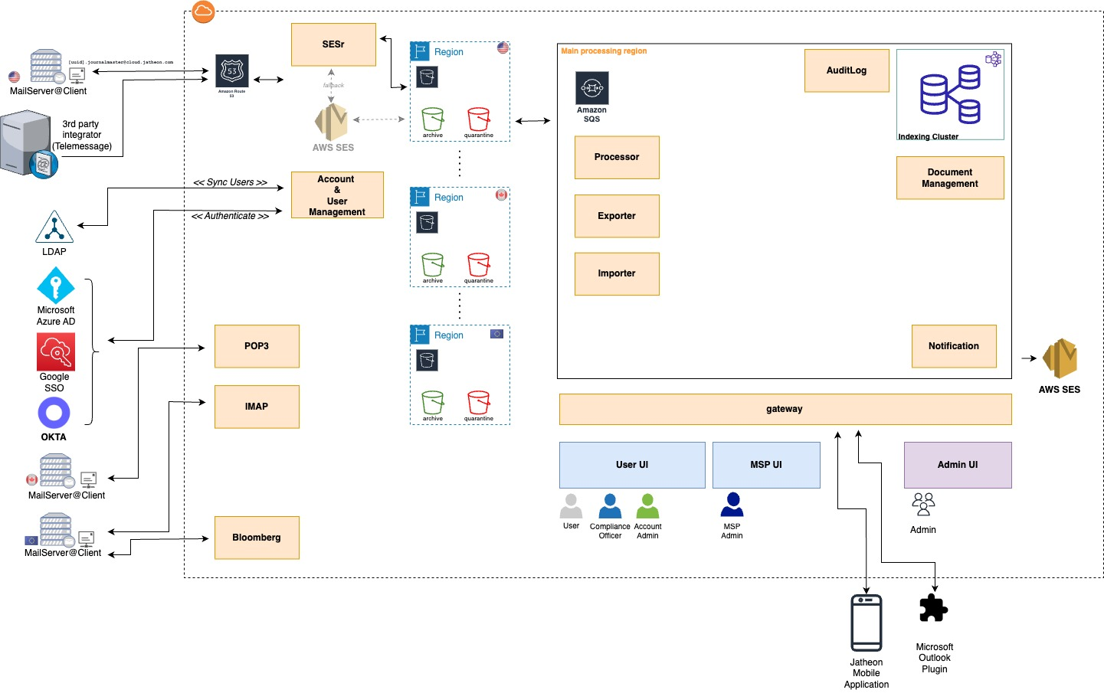
“Elevate The Cloud Game” - Stoisavljević Aleksandar @ 2023

Slide 45
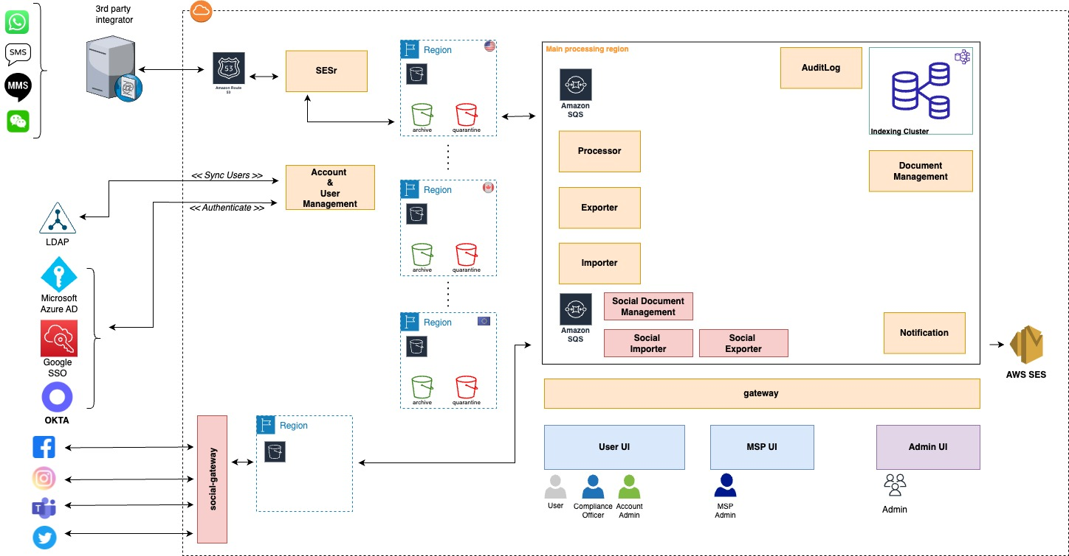
“Elevate The Cloud Game” - Stoisavljević Aleksandar @ 2023

Slide 46

ErgoCloud
Infrastructure
“Elevate The Cloud Game” - Stoisavljević Aleksandar @ 2023

Slide 47
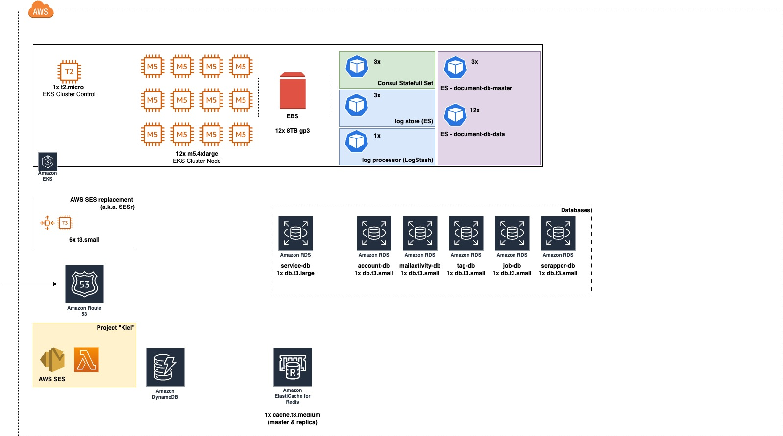
~ 25 services
= 5 CronJobs
“Elevate The Cloud Game” - Stoisavljević Aleksandar @ 2023

Slide 48
ErgoCloud
Key Cost Indicators
“Elevate The Cloud Game” - Stoisavljević Aleksandar @ 2023

Slide 49
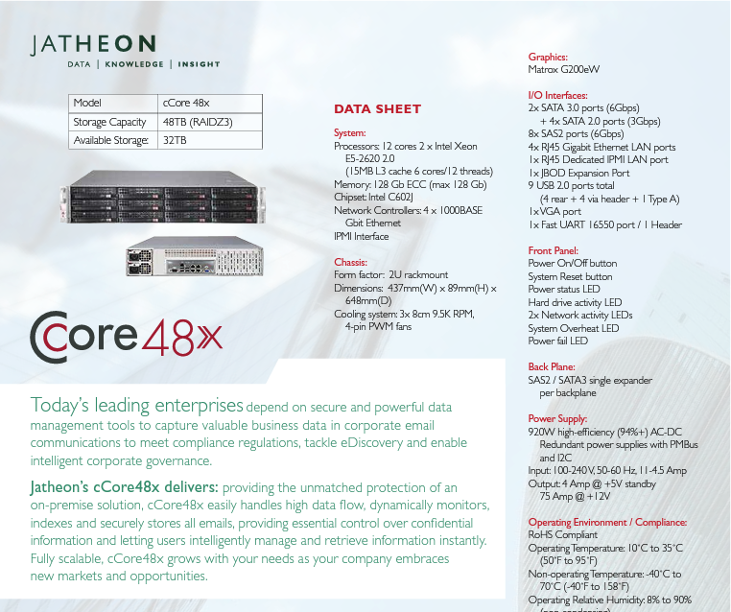
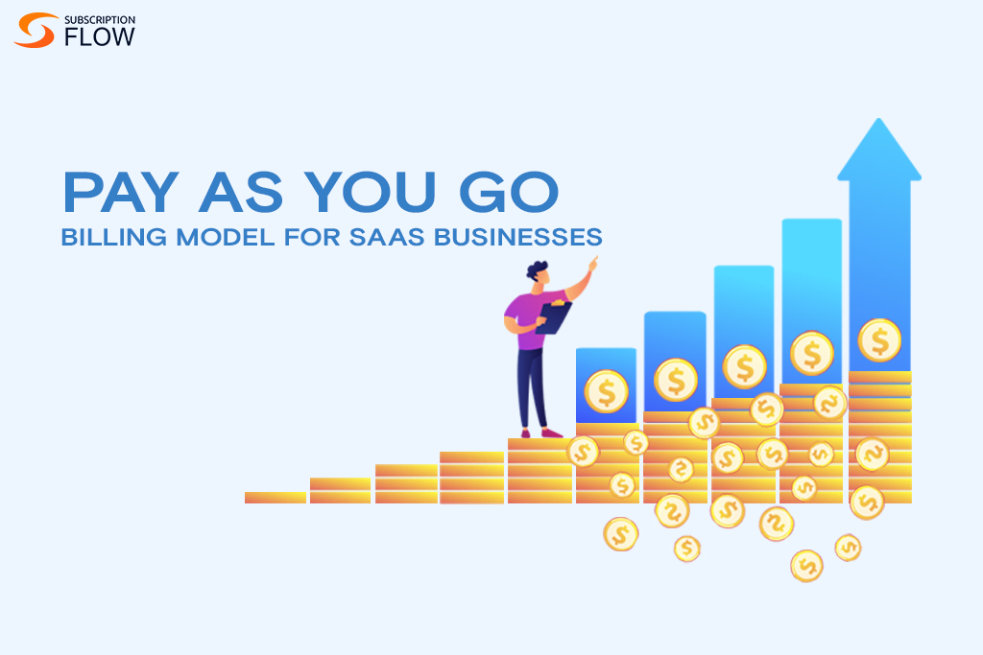
VS.
BUDGET = CAPEX + OPEX
“Elevate The Cloud Game” - Stoisavljević Aleksandar @ 2023

Slide 50
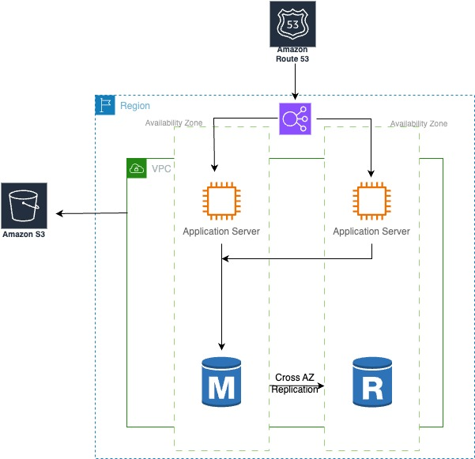
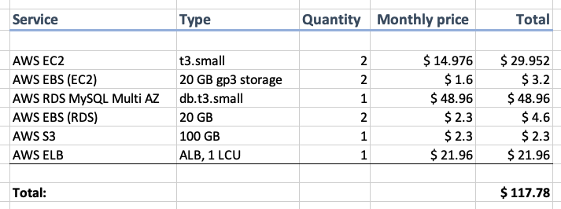
“Elevate The Cloud Game” - Stoisavljević Aleksandar @ 2023
Notes:
!Extract: https://jatheon.com/blog/aws-reduce-costs/

Slide 51
“Hidden” costs?
Costs that you have to be aware of !
Actual Storage Cost
80 %
API HTTP PUT
object to the bucket
2 %
Data Transfer IN
0 %
API HTTP GET
object to the bucket
3 %
Data Transfer OUT
15 %
“Elevate The Cloud Game” - Stoisavljević Aleksandar @ 2023

Slide 52
ErgoCloud
Jatheon - Cost Optimization
“Elevate The Cloud Game” - Stoisavljević Aleksandar @ 2023

Slide 53
ErgoCloud
@BeforeAll
“Someone should take care for
the cost control”
“Elevate The Cloud Game” - Stoisavljević Aleksandar @ 2023

Slide 54
ErgoCloud
COST01
BP01
@BeforeAll
“Someone MUST care for
the cost control!”
“Elevate The Cloud Game” - Stoisavljević Aleksandar @ 2023
Notes:
COST01 - BP01 - Establish a cost optimization function (Page 7.)

Slide 55
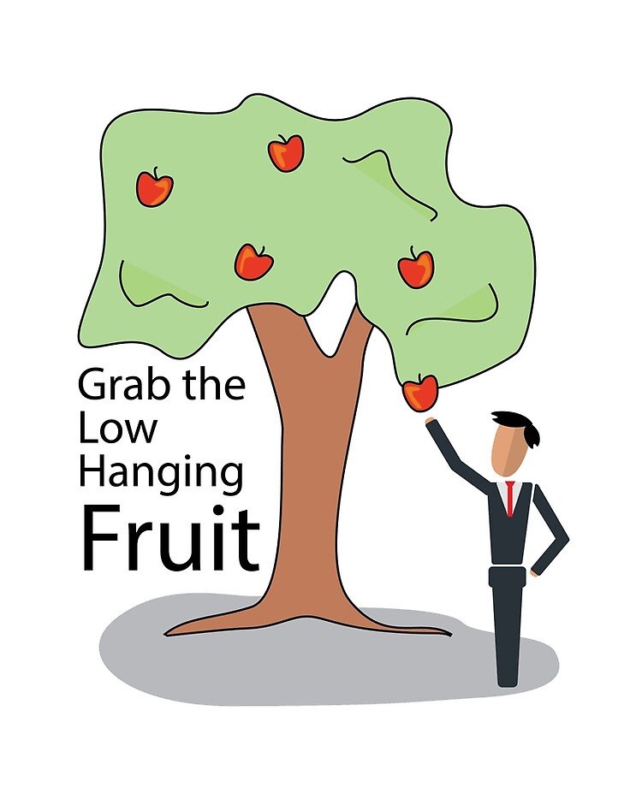

ErgoCloud
Categories
“Elevate The Cloud Game” - Stoisavljević Aleksandar @ 2023

Slide 56
ErgoCloud
COST06
BP03
Reserved Instances (RI)
On-Demand
Category I
“Low Hanging Fruits”
Reserved Instances
Spot Instances
“Elevate The Cloud Game” - Stoisavljević Aleksandar @ 2023
Notes:
COST06 - BP03 - Select resource type, size and number automatically based on metrics (Page 58.)

Slide 57
ErgoCloud
COST06
BP03
Reserved Instances (RI)
Category I
“Low Hanging Fruits”
Amazon EC2 Reserved Instances (RI) provide a significant discount (up to 72%)
compared to On-Demand pricing and provide a capacity reservation when
used in a specific Availability Zone.
t3.medium On-Demand $ 0.0416/h
VS.
t3.medium RI $ 0.026/h
Savings: 38%
Can be purchased for 1-year or 3-years
NOTE: Convertible Reserved Instances
“Elevate The Cloud Game” - Stoisavljević Aleksandar @ 2023
Notes:
COST06 - BP03 - Select resource type, size and number automatically based on metrics (Page 58.)

Slide 58
ErgoCloud
COST06
BP03
Savings Plans (SP)
Category I
“Low Hanging Fruits”
Savings Plans is a flexible pricing model offering lower prices compared to On-Demand pricing,
in exchange for a specific usage commitment (measured in $/hour) for a one- or three-year period.
There are 3 types of Savings Plans (SP):
Compute Savings Plans
EC2 Instance Savings Plans
SageMaker Savings Plans
Make a commitment to Savings Plans by using the recommendations provided in AWS Cost Explorer to realize the biggest savings. The recommended hourly commitment is based on your historical On Demand usage and your choice of plan type, term length, and payment option. Once you sign up for a Savings Plan, your compute usage will automatically be charged at the discounted Savings Plans prices and any usage beyond your commitment will be charged at regular On Demand rates.
REVISIT
“Elevate The Cloud Game” - Stoisavljević Aleksandar @ 2023
Notes:
COST06 - BP03 - Select resource type, size and number automatically based on metrics (Page 58.)

Slide 59
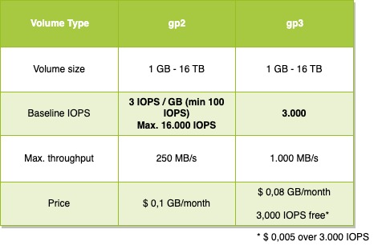
ErgoCloud
COST01
BP07
EBS Migration
Category I
“Low Hanging Fruits”
General Purpose SSD volume type (GP2) provided a cost effective way to achieve SSD performance
for variety of applications.
Performance is coupled with provisioned size and increases linearly with the volume size.
December 2020. AWS announced
general availability of
new EBS General Purpose SSD
volume type (GP3).
“Elevate The Cloud Game” - Stoisavljević Aleksandar @ 2023
Notes:
COST01 - BP07 - Keep up-to-date with new service releases (Page 18.)
https://aws.amazon.com/blogs/storage/migrate-your-amazon-ebs-volumes-from-gp2-to-gp3-and-save-up-to-20-on-costs/

Slide 60
ErgoCloud
COST06
BP03
Category I
“Low Hanging Fruits”
AWS RDS Optimization
“Elevate The Cloud Game” - Stoisavljević Aleksandar @ 2023
Notes:
COST06 - BP03 - Select resource type, size and number automatically based on metrics (Page 58.)

Slide 61

ErgoCloud
Project based tasks
Category I
“Low Hanging Fruits”
Category II
Project based tasks
“Elevate The Cloud Game” - Stoisavljević Aleksandar @ 2023

Slide 62
ErgoCloud
Category I
“Low Hanging Fruits”
Category II
Project based tasks
Project “Kiel”
“Elevate The Cloud Game” - Stoisavljević Aleksandar @ 2023

Slide 63
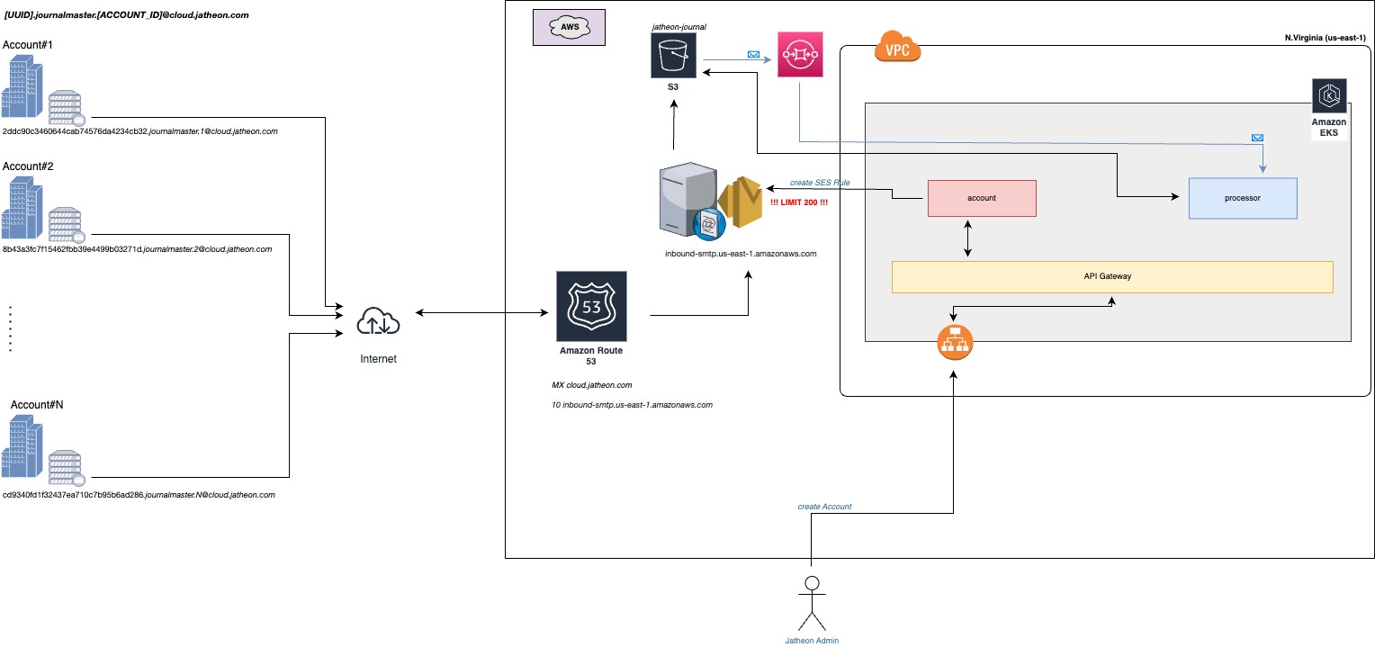
ErgoCloud
Project “Kiel”
Category I
“Low Hanging Fruits”
Category II
Project based tasks
“Elevate The Cloud Game” - Stoisavljević Aleksandar @ 2023

Slide 64
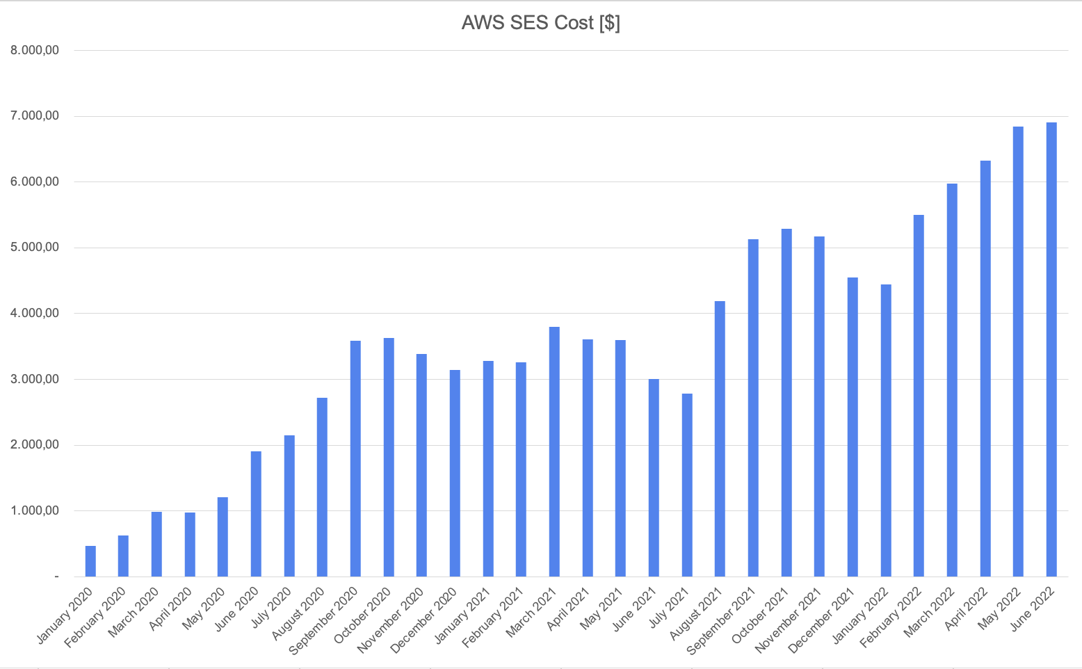
ErgoCloud
Project “Kiel”
Category I
“Low Hanging Fruits”
Category II
Project based tasks
“Elevate The Cloud Game” - Stoisavljević Aleksandar @ 2023

Slide 65
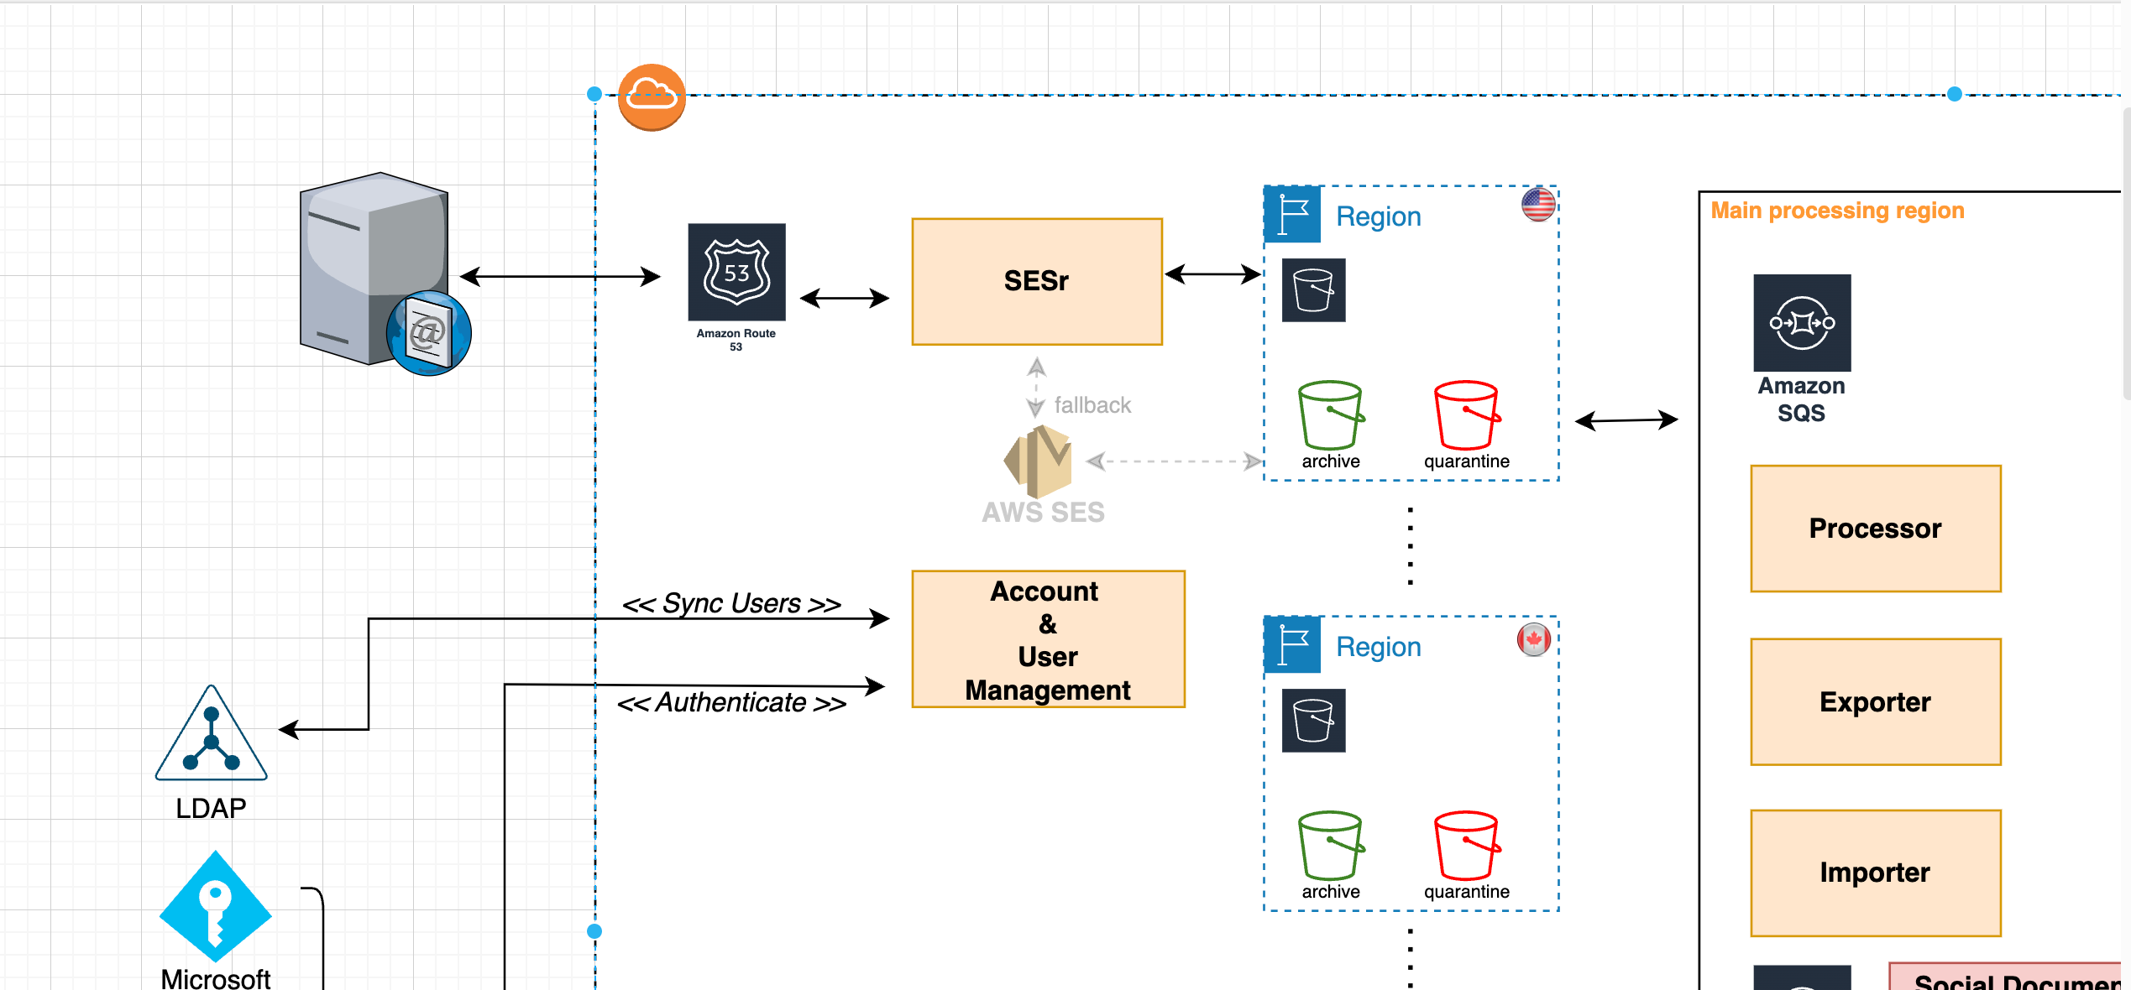
ErgoCloud
Project “Kiel” [SES Replacement - SESr]
Category I
“Low Hanging Fruits”
Category II
Project based tasks
“Elevate The Cloud Game” - Stoisavljević Aleksandar @ 2023

Slide 66
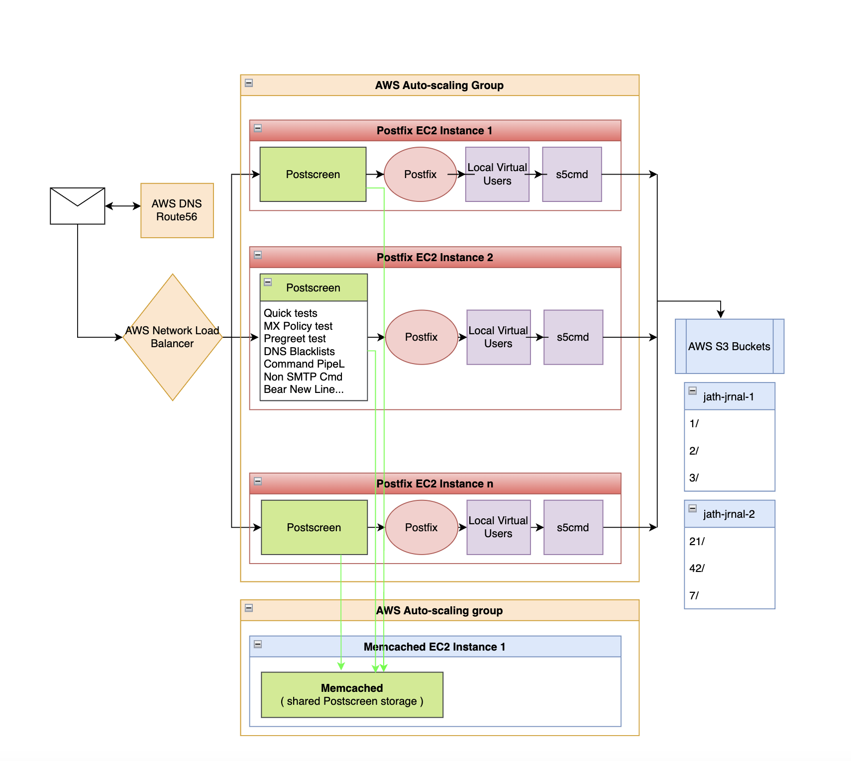
ErgoCloud
Project “Kiel” [SES Replacement - SESr]
Category I
“Low Hanging Fruits”
Category II
Project based tasks
REVISIT
3 x t3.small ( 2 vCPU, RAM 2 GB) + 1 x t3.small
4 x t3.small x 15,6 $/month = 62,4 $/month
2 AZ - 2 x 62,4 $/month = 124,8 $/month
“Elevate The Cloud Game” - Stoisavljević Aleksandar @ 2023

Slide 67
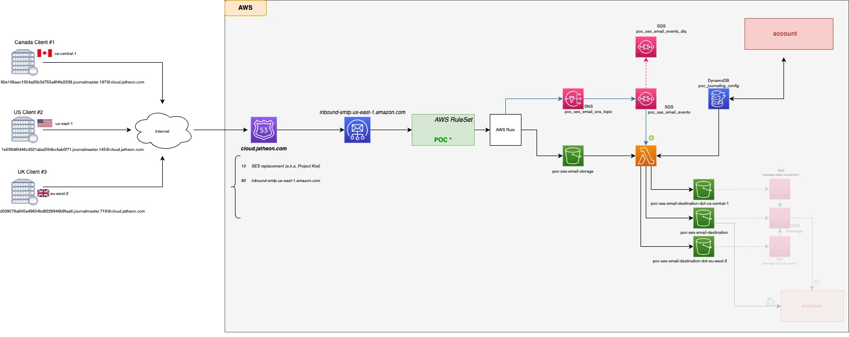
ErgoCloud
Project “Kiel” [SES Replacement - SESr]
Category I
“Low Hanging Fruits”
Category II
Project based tasks
“Elevate The Cloud Game” - Stoisavljević Aleksandar @ 2023

Slide 68
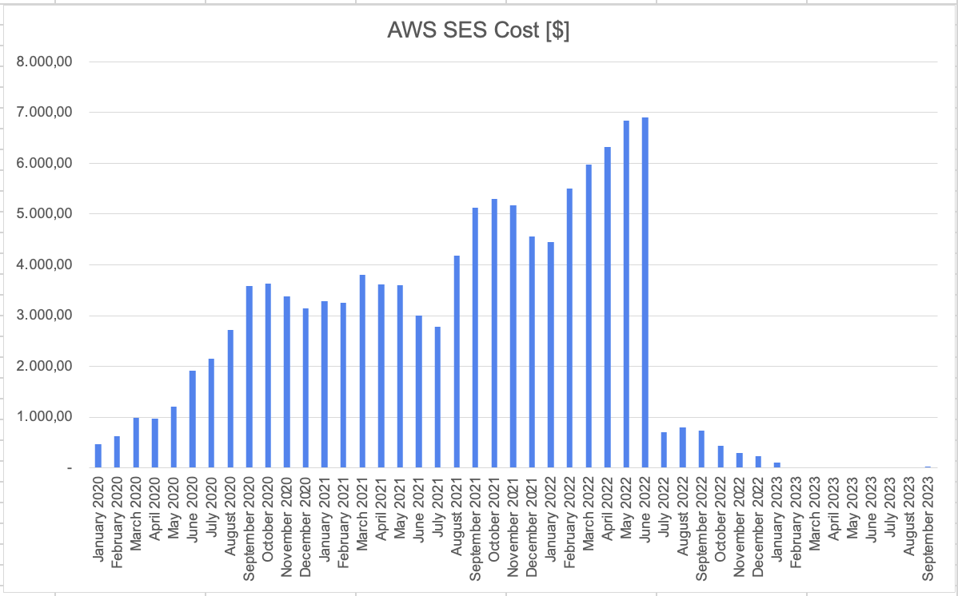
ErgoCloud
Project “Kiel” [SES Replacement - SESr]
Category I
“Low Hanging Fruits”
Category II
Project based tasks
“Elevate The Cloud Game” - Stoisavljević Aleksandar @ 2023

Slide 69
ErgoCloud
Category I
“Low Hanging Fruits”
Category II
Project based tasks
Project “Lima”
“Elevate The Cloud Game” - Stoisavljević Aleksandar @ 2023

Slide 70
ErgoCloud
Project “Lima”
Category I
“Low Hanging Fruits”
Jatheon is Archiving Company
Category II
Project based tasks
Acquired Data Can Only Be Getting
BIGGER
And
BIGGER
“Elevate The Cloud Game” - Stoisavljević Aleksandar @ 2023

Slide 71
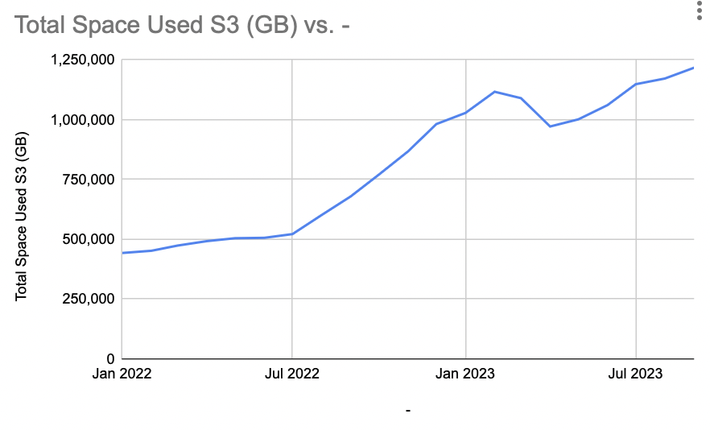
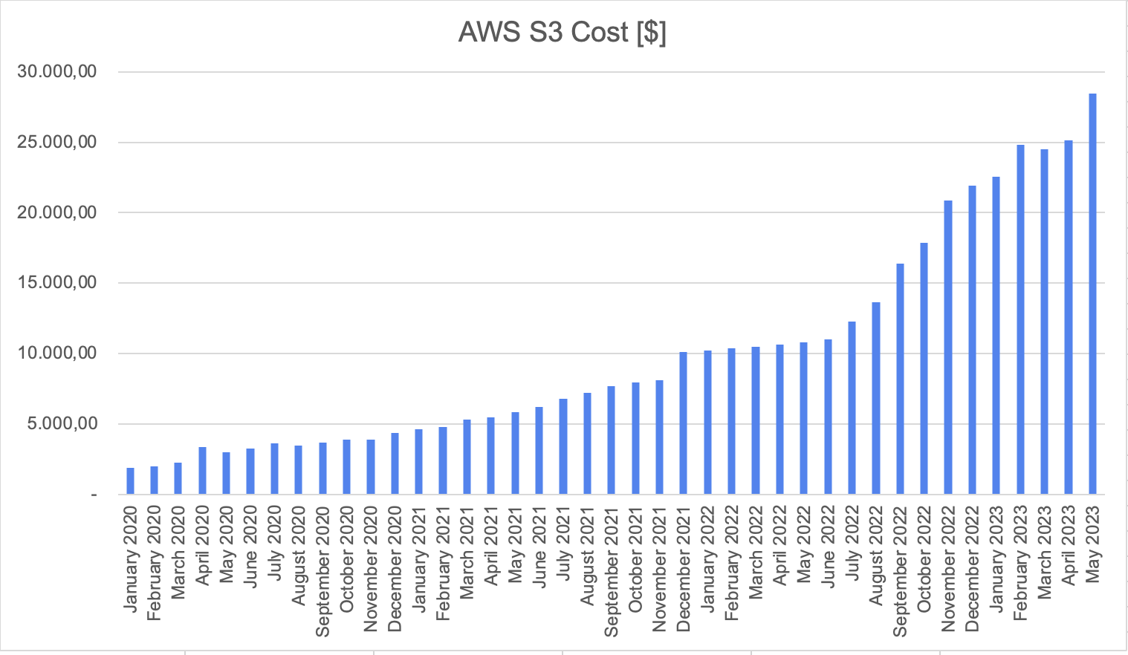
ErgoCloud
Project “Lima”
Category I
“Low Hanging Fruits”
Category II
Project based tasks
“Elevate The Cloud Game” - Stoisavljević Aleksandar @ 2023

Slide 72
“Elevate The Cloud Game” - Stoisavljević Aleksandar @ 2023

Slide 73
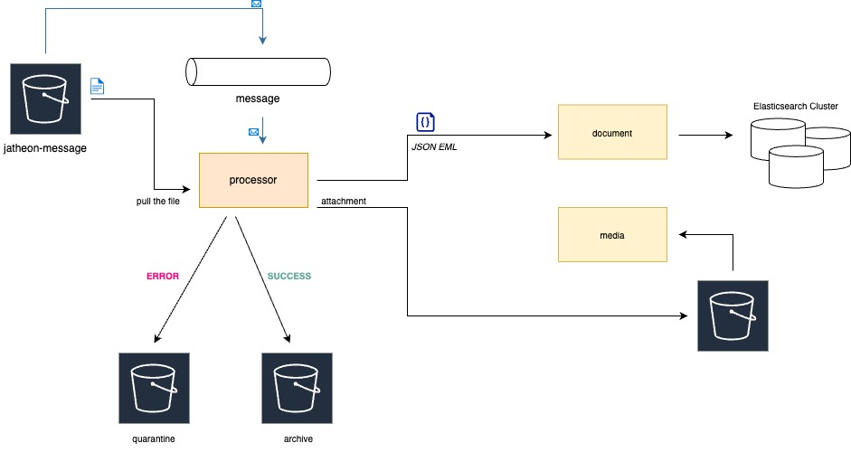
ErgoCloud
Project “Lima”
Category I
“Low Hanging Fruits”
Category II
Project based tasks
“Elevate The Cloud Game” - Stoisavljević Aleksandar @ 2023

Slide 74
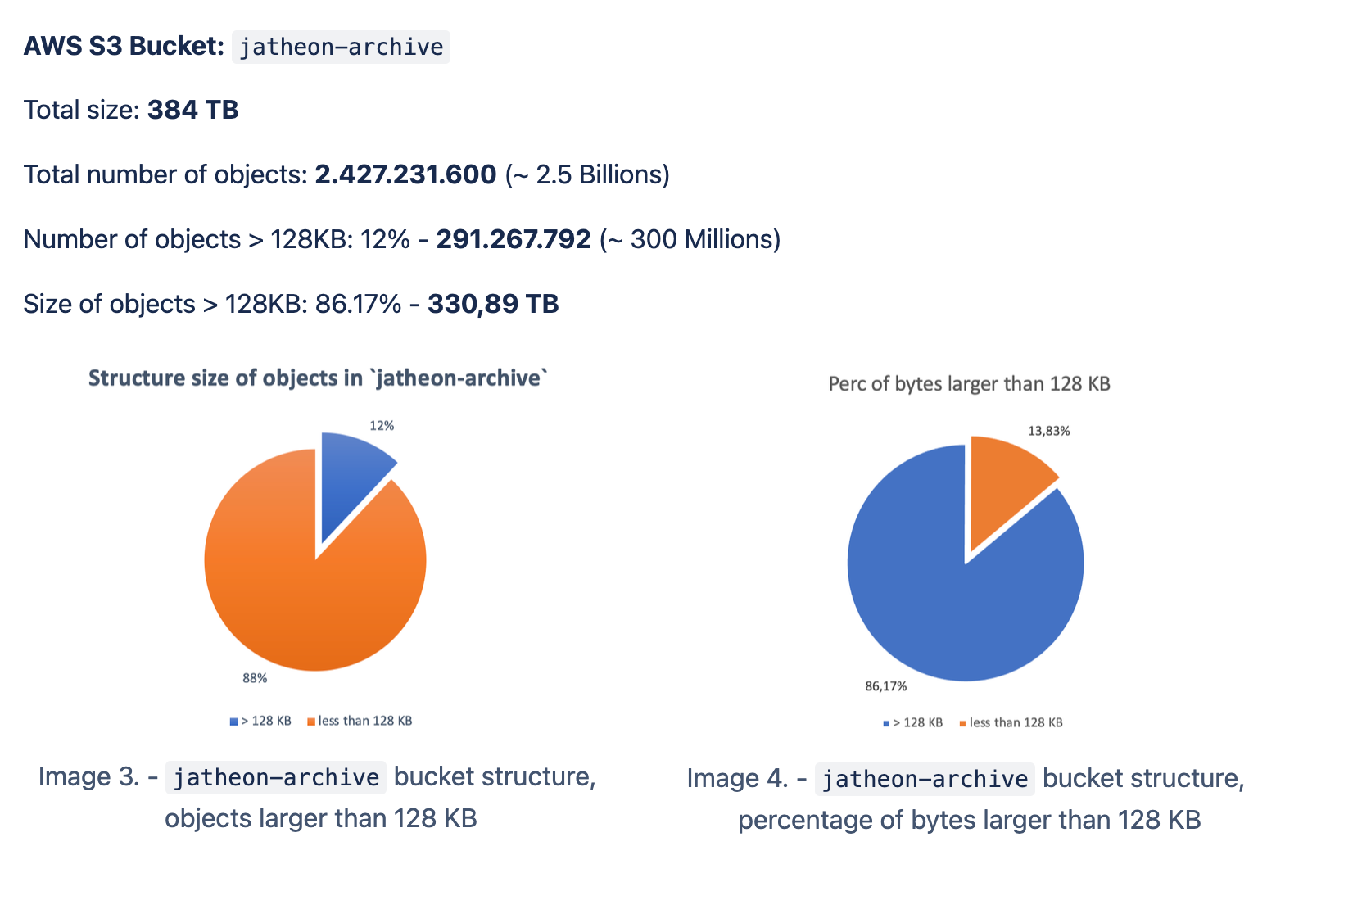
ErgoCloud
Project “Lima”
Snapshot February 2023.
Category I
“Low Hanging Fruits”
Category II
Project based tasks
“Elevate The Cloud Game” - Stoisavljević Aleksandar @ 2023

Slide 75
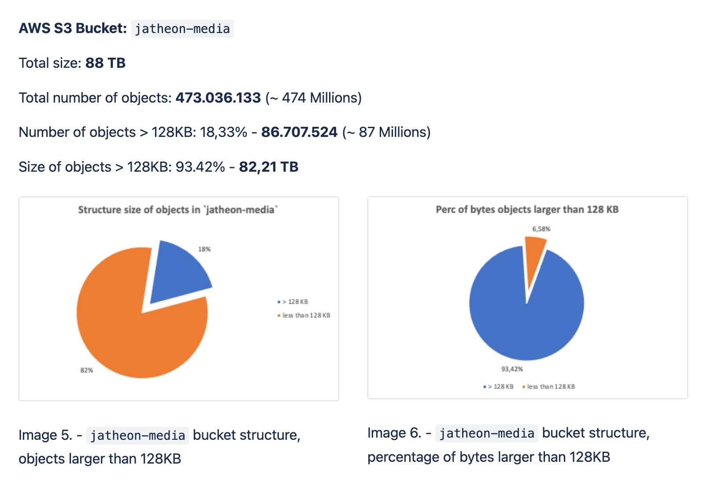
ErgoCloud
Project “Lima”
Snapshot February 2023.
Category I
“Low Hanging Fruits”
Category II
Project based tasks
“Elevate The Cloud Game” - Stoisavljević Aleksandar @ 2023

Slide 76
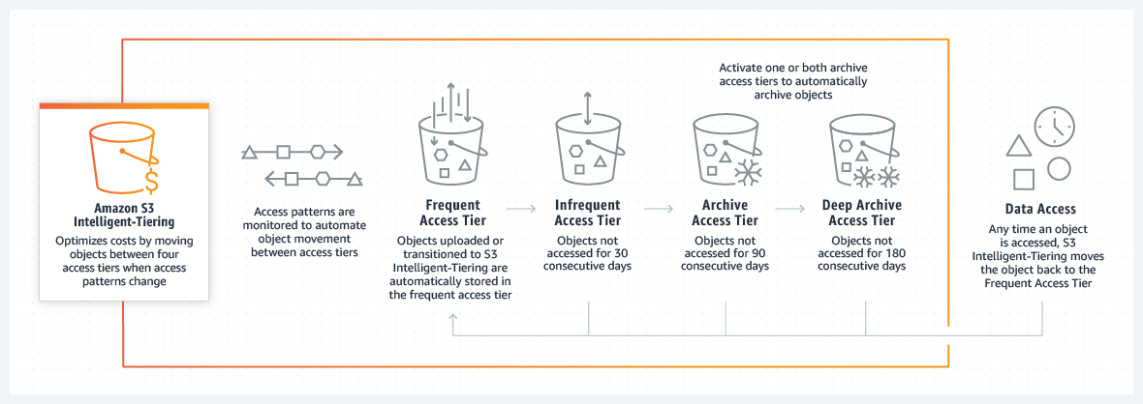
ErgoCloud
Project “Lima”
Category I
“Low Hanging Fruits”
Category II
Project based tasks
“Elevate The Cloud Game” - Stoisavljević Aleksandar @ 2023

Slide 77
ErgoCloud
Project “Lima”
AWS S3 Standard - $ 0,023 / GB / month
Category I
“Low Hanging Fruits”
~ 1.250.000 GB x $ 0,023 GB/month = 28.750 $/month
Category II
Project based tasks
VS.
AWS S3 INT Tiering
AWS S3 INT Tiering - Frequent Access Tier - $ 0,023 / GB / month
AWS S3 INT Tiering - Infrequent Access Tier - $ 0,0125 / GB / month
AWS S3 INT Tiering - Archive Instant Access Tier - $ 0,004 / GB / month
“Elevate The Cloud Game” - Stoisavljević Aleksandar @ 2023

Slide 78
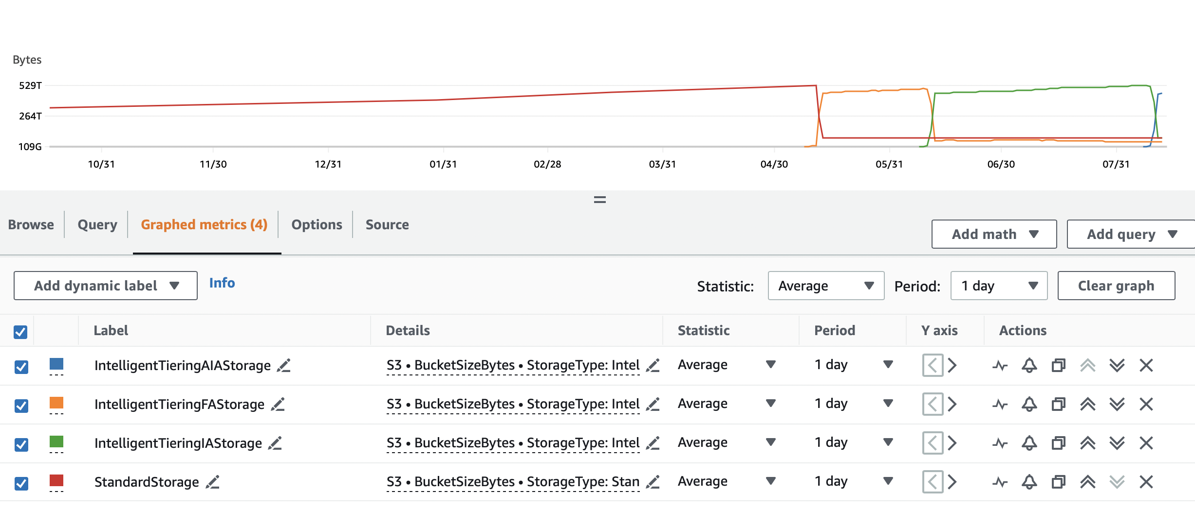
ErgoCloud
Project “Lima”
Category I
“Low Hanging Fruits”
Category II
Project based tasks
“Elevate The Cloud Game” - Stoisavljević Aleksandar @ 2023

Slide 79
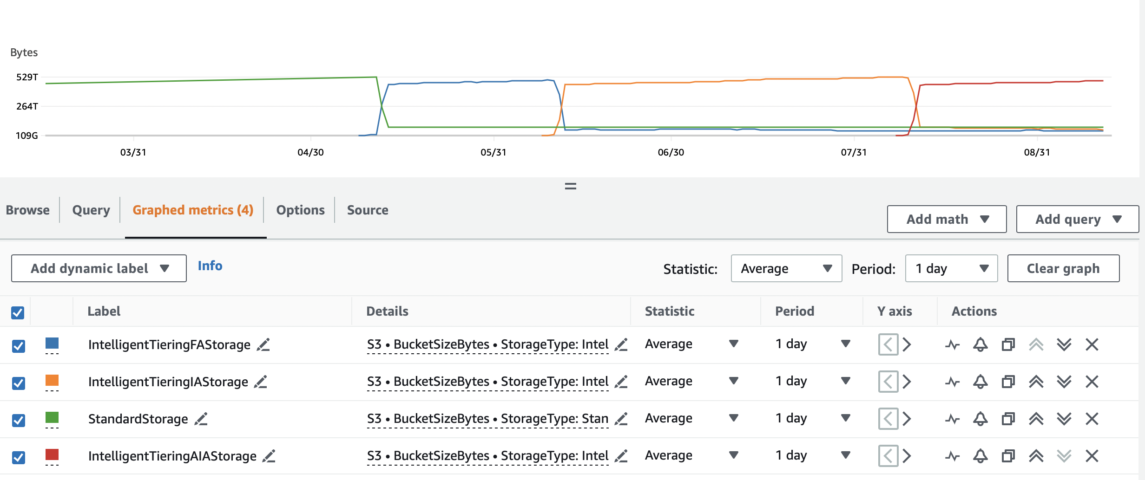
ErgoCloud
Project “Lima”
Category I
“Low Hanging Fruits”
Category II
Project based tasks
“Elevate The Cloud Game” - Stoisavljević Aleksandar @ 2023

Slide 80
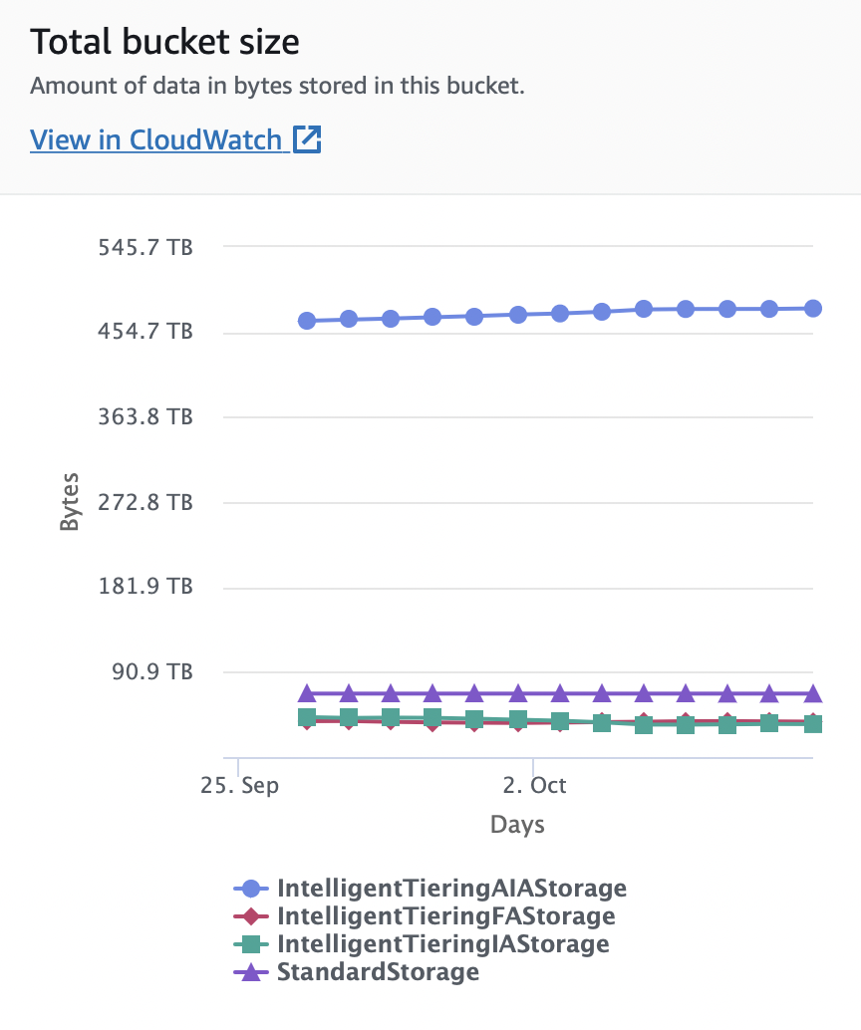
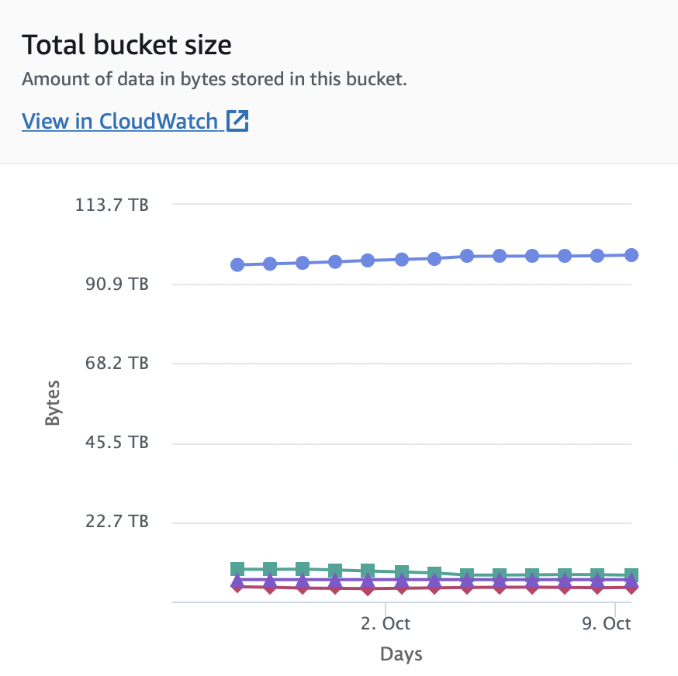
ErgoCloud
Project “Lima”
Category I
“Low Hanging Fruits”
Category II
Project based tasks
“Elevate The Cloud Game” - Stoisavljević Aleksandar @ 2023

Slide 81
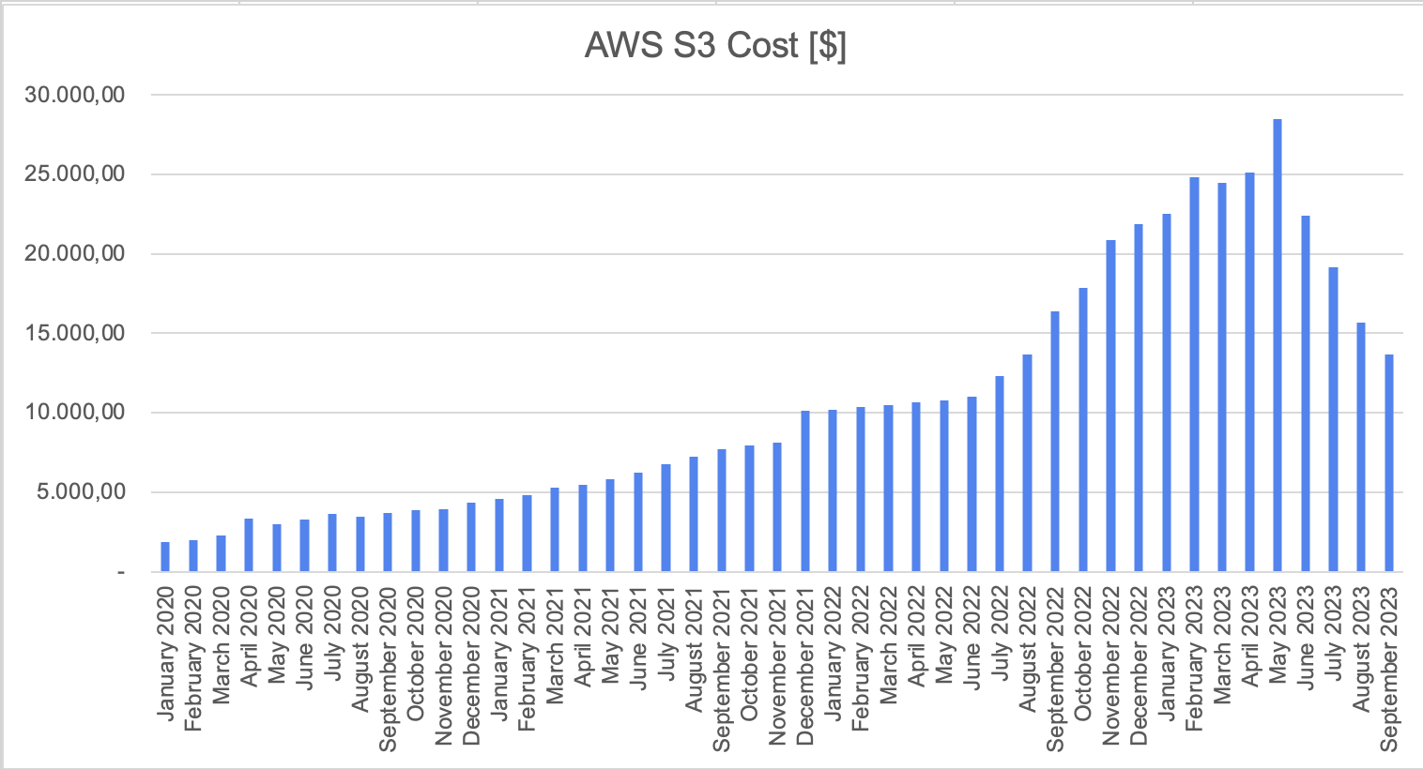
ErgoCloud
Project “Lima”
Category I
“Low Hanging Fruits”
Category II
Project based tasks
“Elevate The Cloud Game” - Stoisavljević Aleksandar @ 2023

Slide 82
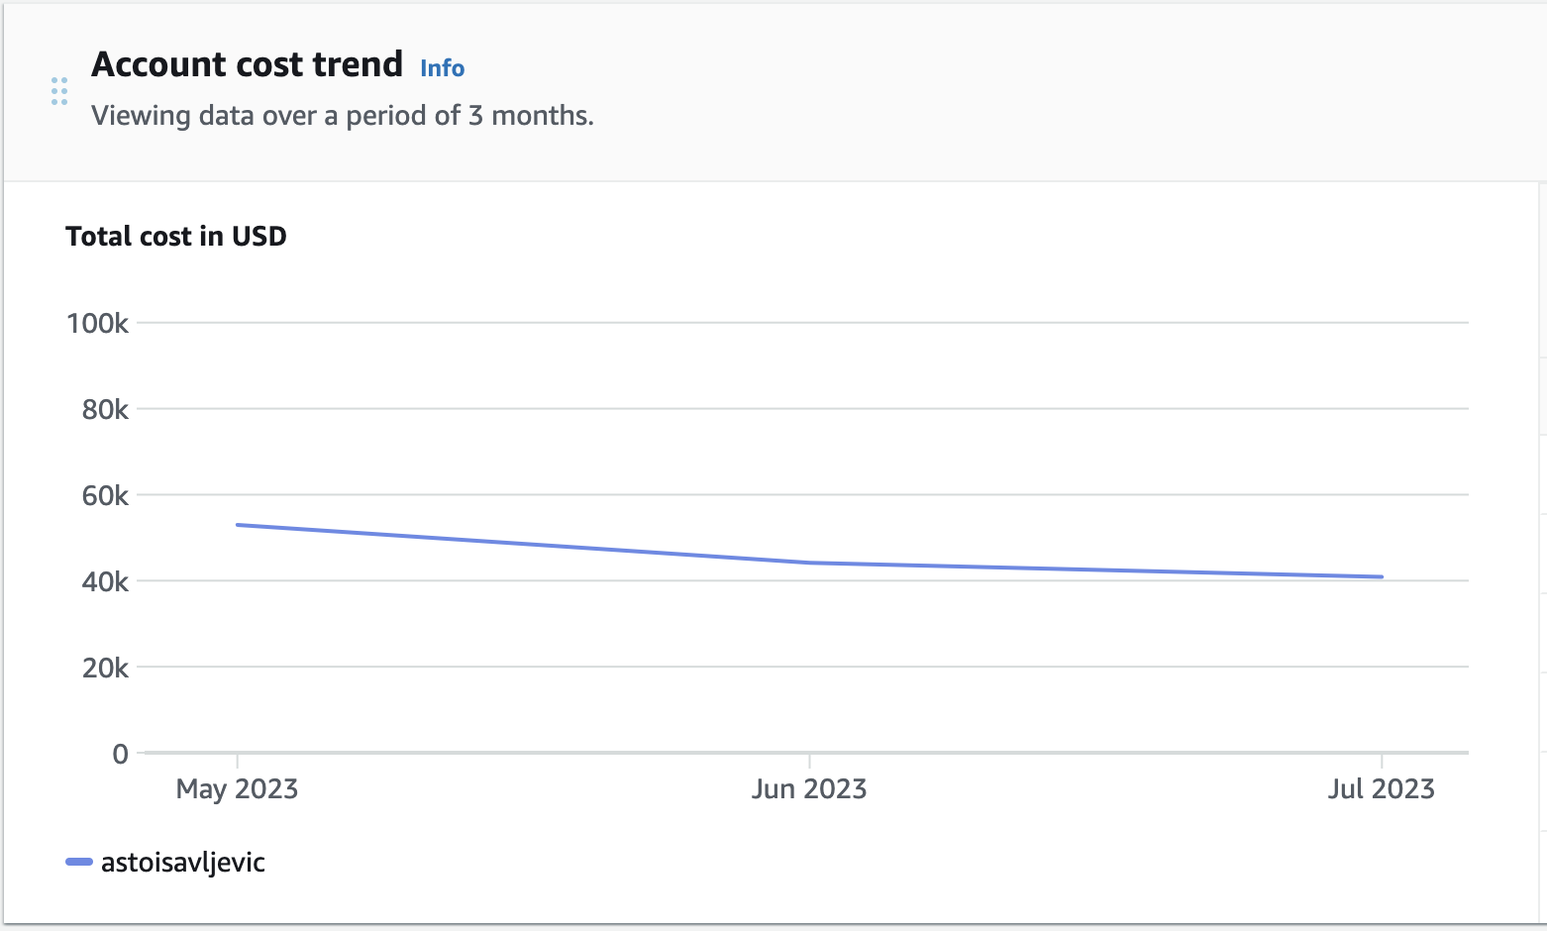
ErgoCloud
Project “Lima”
Category I
“Low Hanging Fruits”
Category II
Project based tasks
“Elevate The Cloud Game” - Stoisavljević Aleksandar @ 2023

Slide 83
ErgoCloud
COST02
BP03
Category I
“Low Hanging Fruits”
Category II
Project based tasks
Project “Bern”
“Elevate The Cloud Game” - Stoisavljević Aleksandar @ 2023

Slide 84
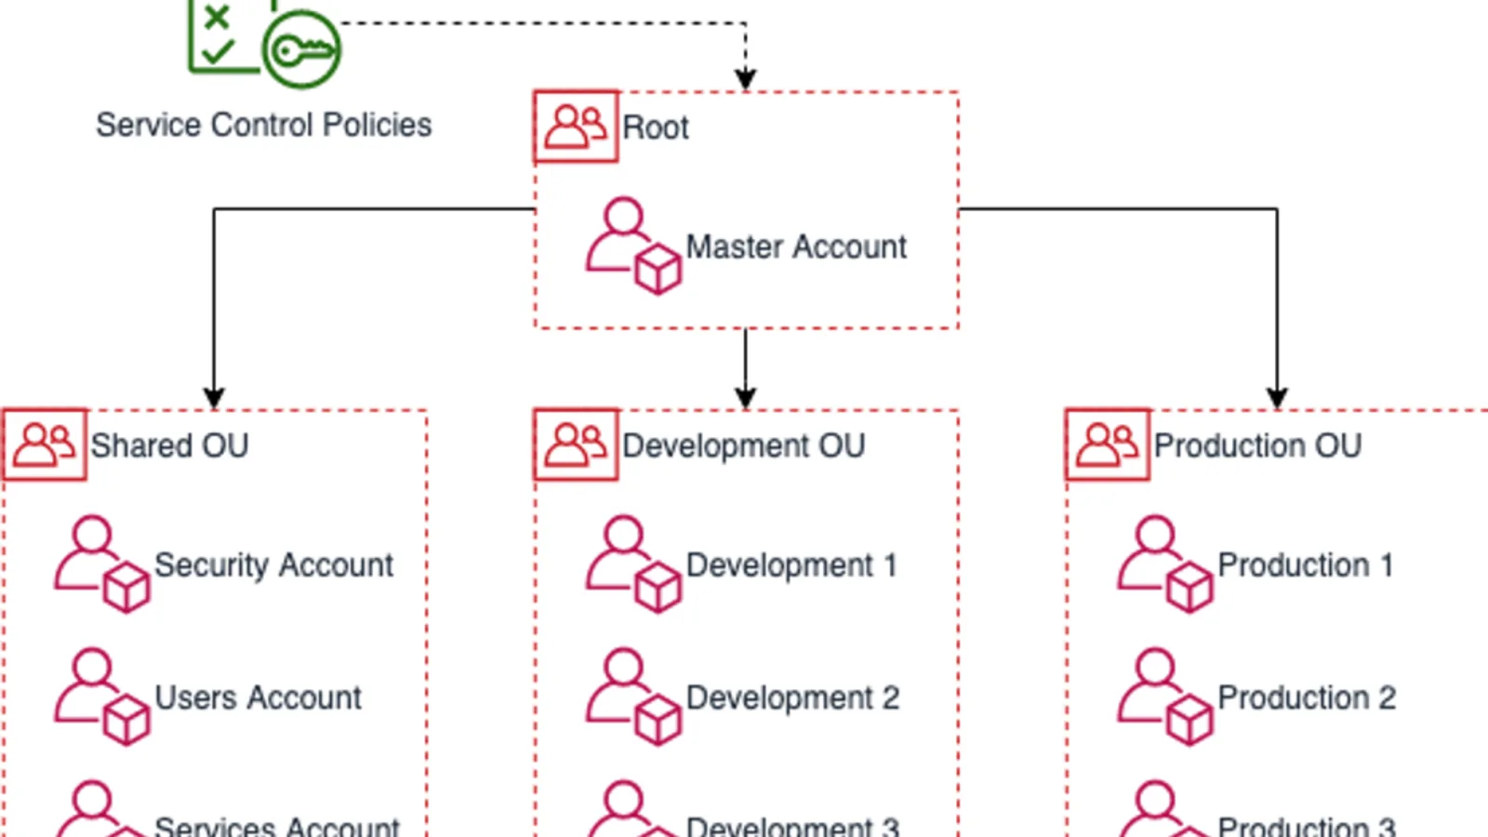
ErgoCloud
COST02
BP03
Project “Bern”
Category I
“Low Hanging Fruits”
Implement a structure of accounts that maps well to your organization. This assists in allocating and managing costs throughout your organization.
Category II
Project based tasks
“Elevate The Cloud Game” - Stoisavljević Aleksandar @ 2023
Notes:
COST02-BP03 Implement an account structure (Page 26.)

Slide 85
ErgoCloud
COST02
BP03
Project “Bern”
Category I
“Low Hanging Fruits”
DTAP / DSP
Category II
Project based tasks
AWS EKS “on-premisse”?
“Elevate The Cloud Game” - Stoisavljević Aleksandar @ 2023
Notes:
COST02-BP03 Implement an account structure (Page 26.)

Slide 86

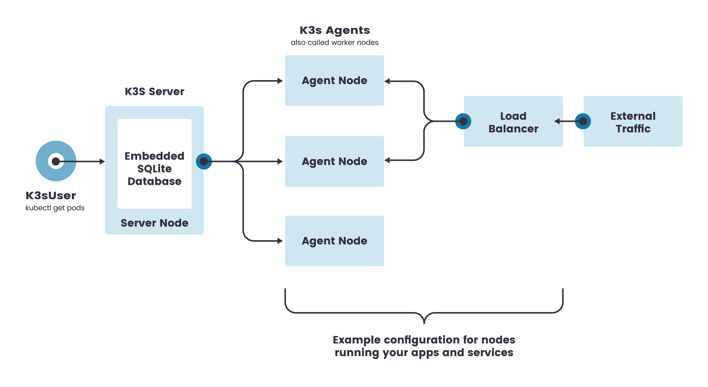
ErgoCloud
COST02
BP03
Project “Bern”
Category I
“Low Hanging Fruits”
Category II
Project based tasks
“Elevate The Cloud Game” - Stoisavljević Aleksandar @ 2023
Notes:
COST02-BP03 Implement an account structure (Page 26.)

Slide 87
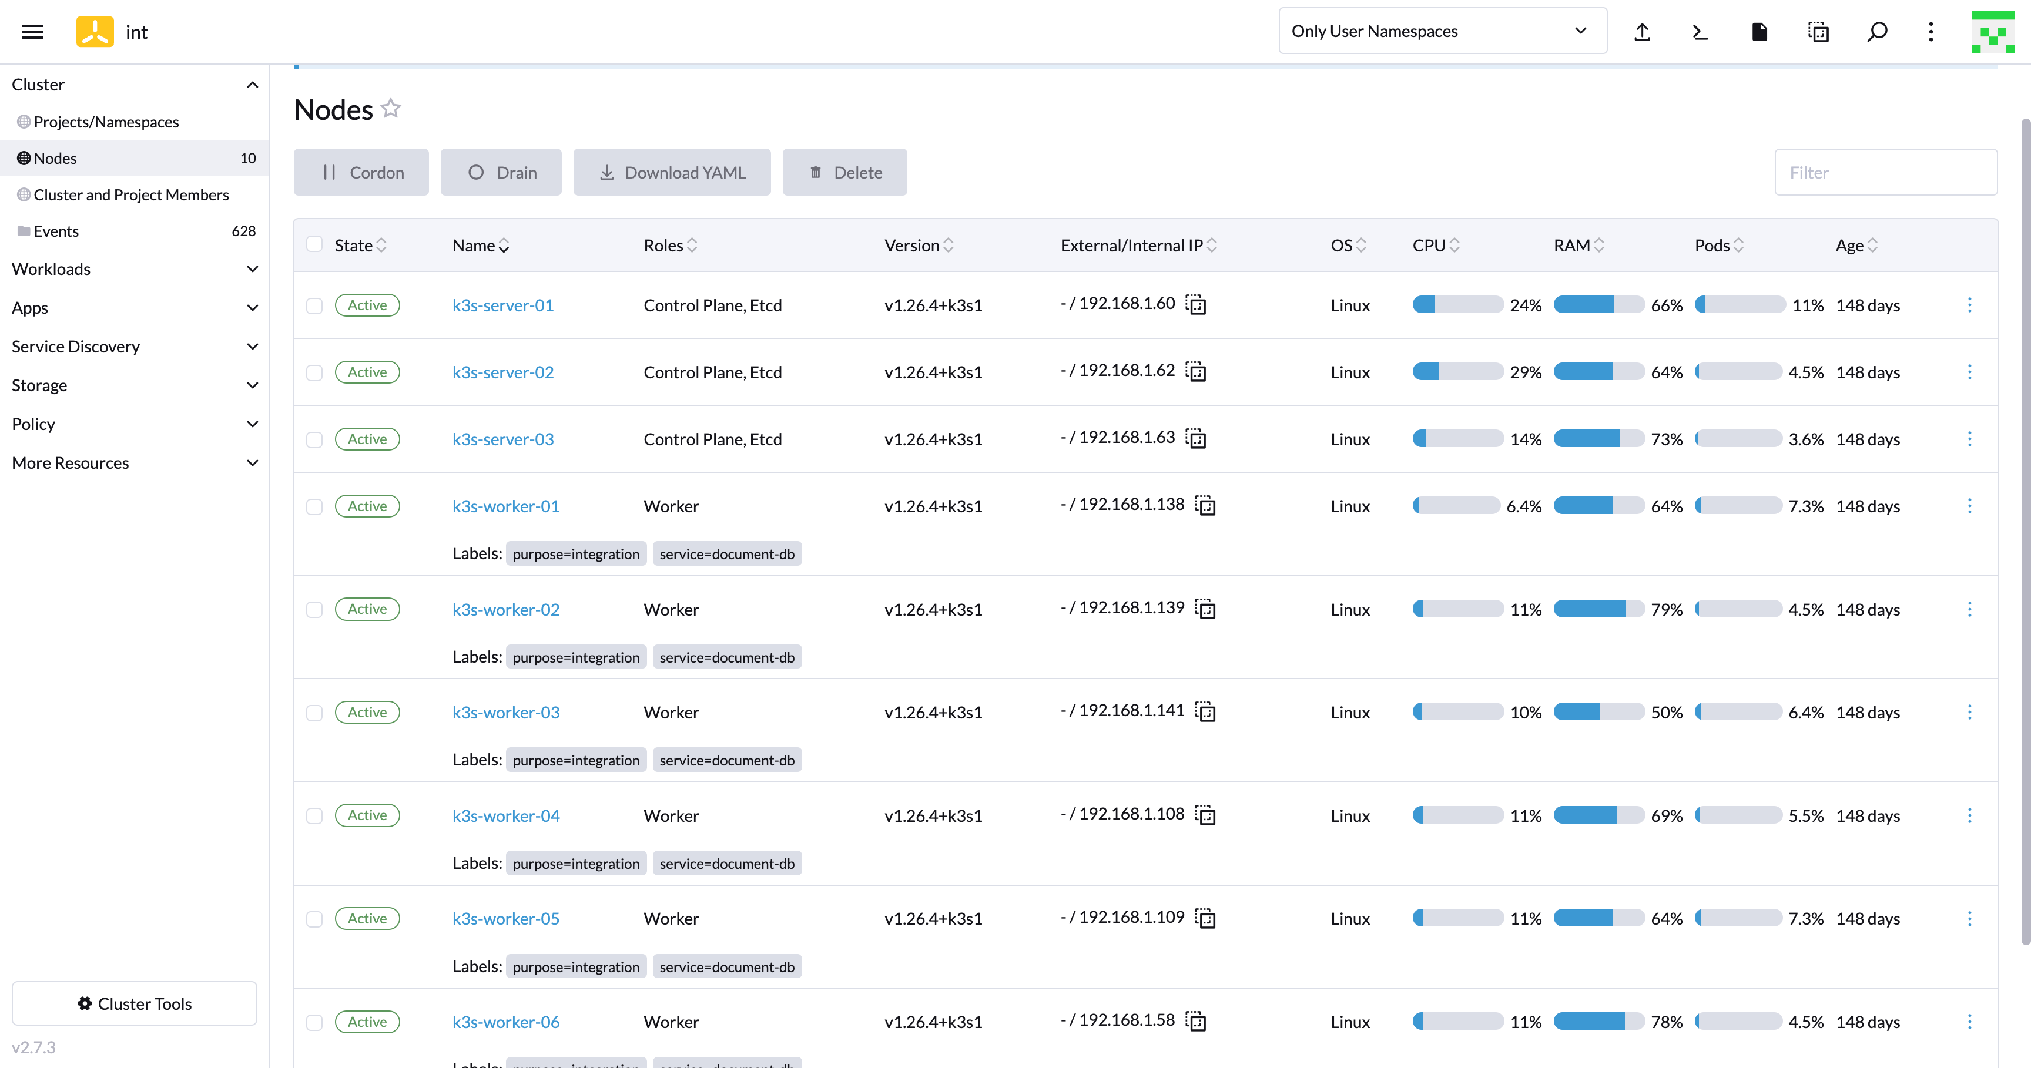
ErgoCloud
COST02
BP03
Project “Bern”
Category I
“Low Hanging Fruits”
Category II
Project based tasks
“Elevate The Cloud Game” - Stoisavljević Aleksandar @ 2023
Notes:
COST02-BP03 Implement an account structure (Page 26.)

Slide 88
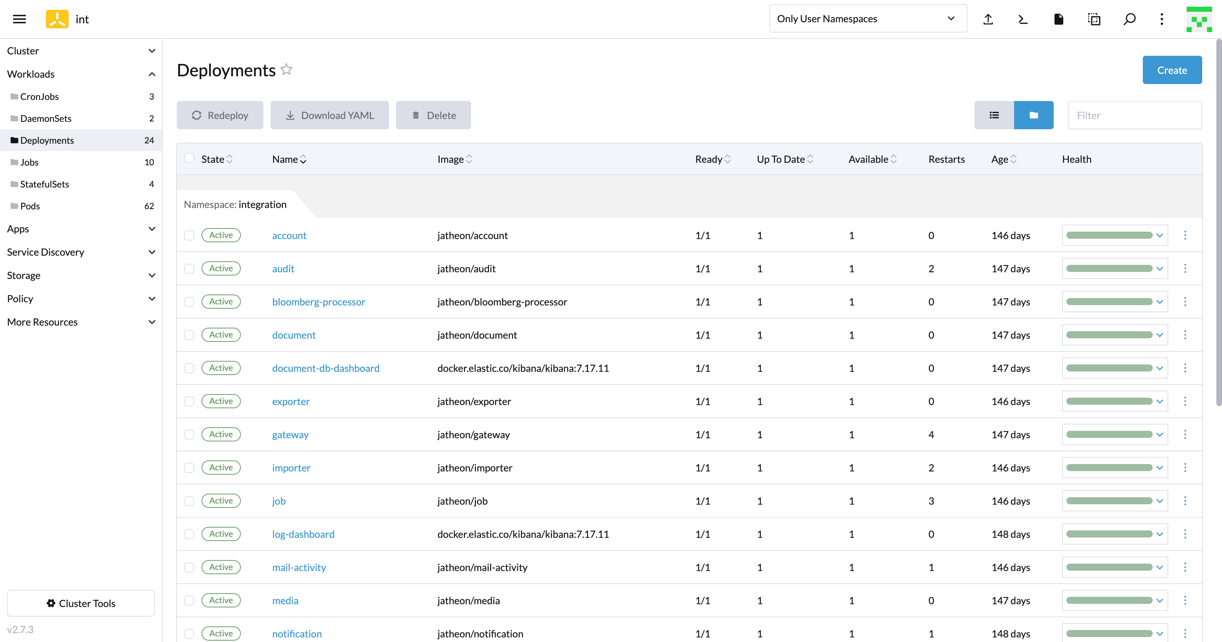
ErgoCloud
COST02
BP03
Project “Bern”
Category I
“Low Hanging Fruits”
Category II
Project based tasks
“Elevate The Cloud Game” - Stoisavljević Aleksandar @ 2023
Notes:
COST02-BP03 Implement an account structure (Page 26.)

Slide 89
ErgoCloud
Monitor cost proactively
Category I
“Low Hanging Fruits”
Report and notify on cost optimization
Quantify business value from cost optimization
Category II
Project based tasks
AWS Resource Tagging Best Practice
Implement regions based on cost
Category III
Other stuff
AWS Organisations & consolidate billing
… and many other that we learned along the way!
“Elevate The Cloud Game” - Stoisavljević Aleksandar @ 2023

Slide 90
ErgoCloud
Billing & Cost Tooling
“Elevate The Cloud Game” - Stoisavljević Aleksandar @ 2023

Slide 91
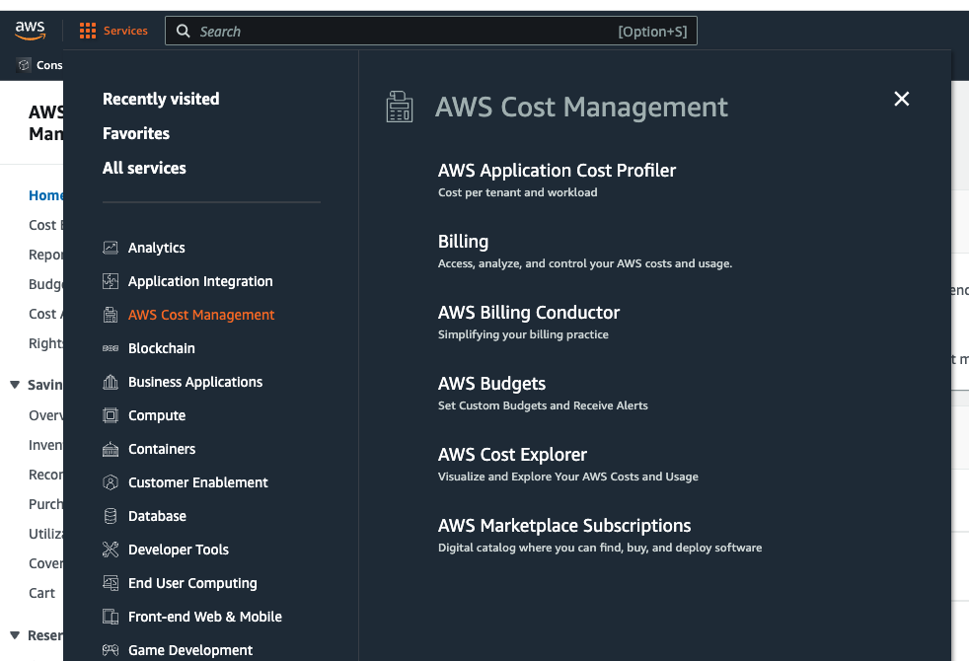
AWS Cost Management
“Elevate The Cloud Game” - Stoisavljević Aleksandar @ 2023

Slide 92
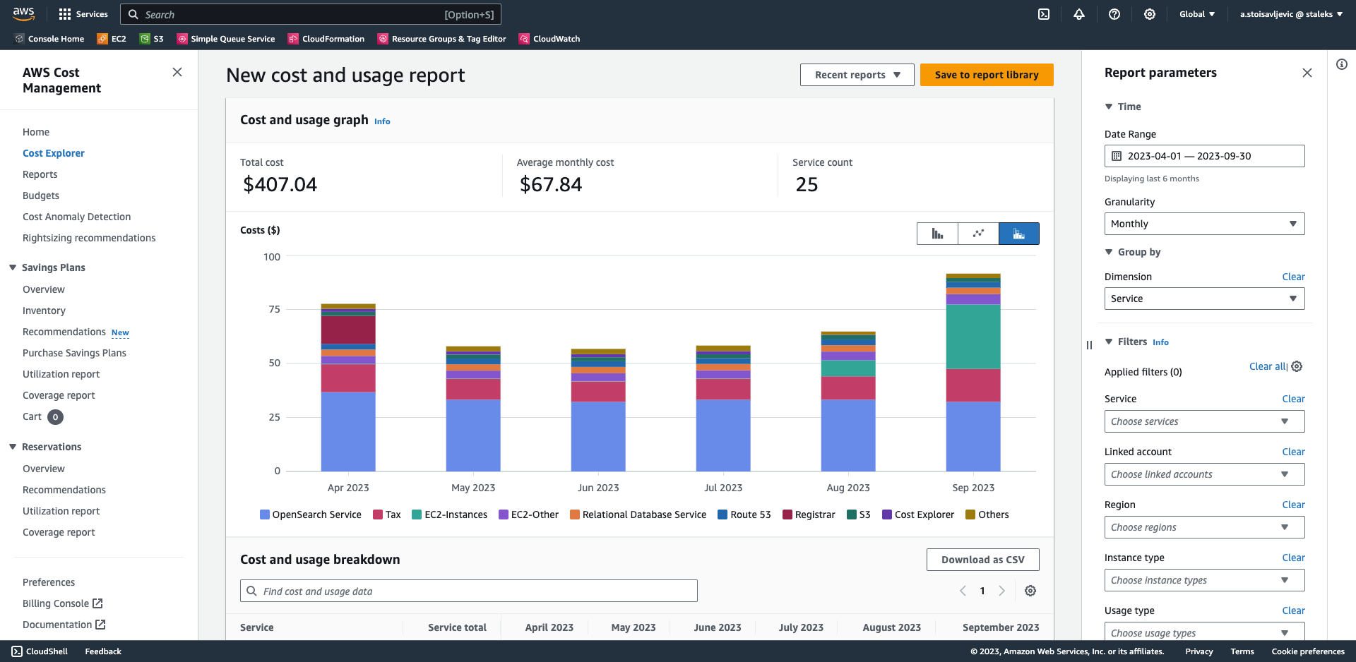
AWS Cost Explorer
“Elevate The Cloud Game” - Stoisavljević Aleksandar @ 2023

Slide 93
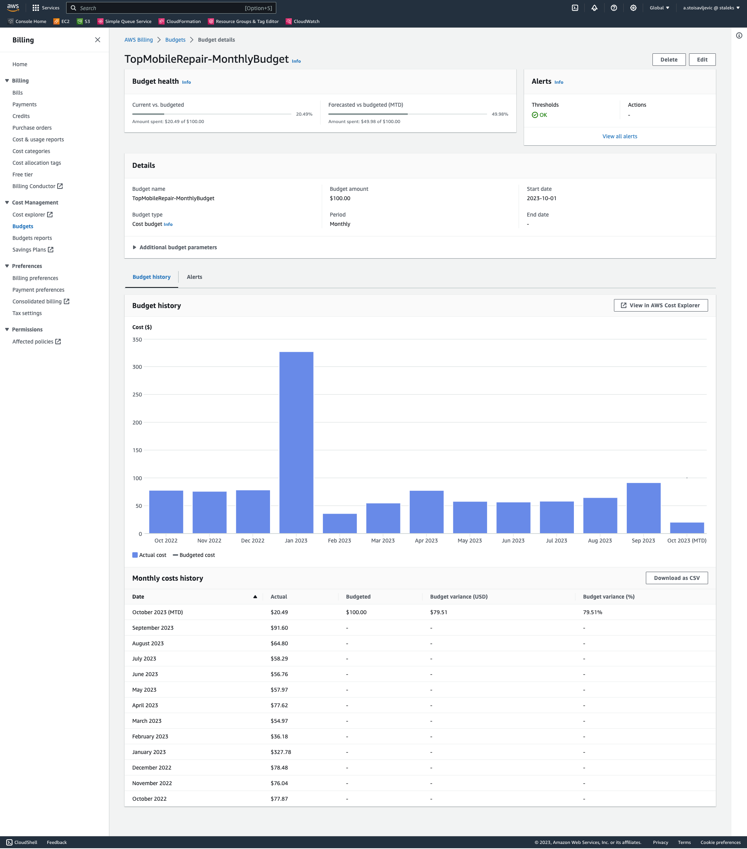
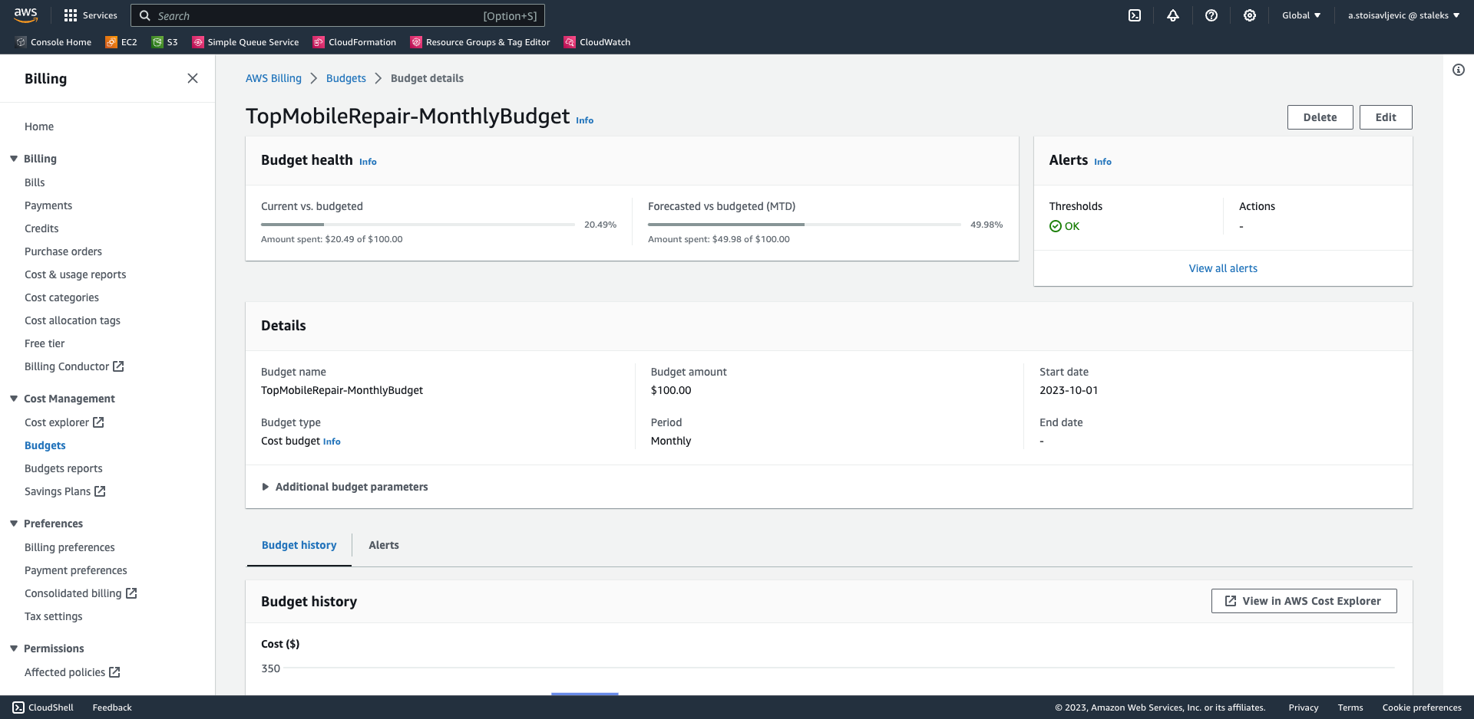
AWS Budgets
“Elevate The Cloud Game” - Stoisavljević Aleksandar @ 2023

Slide 94
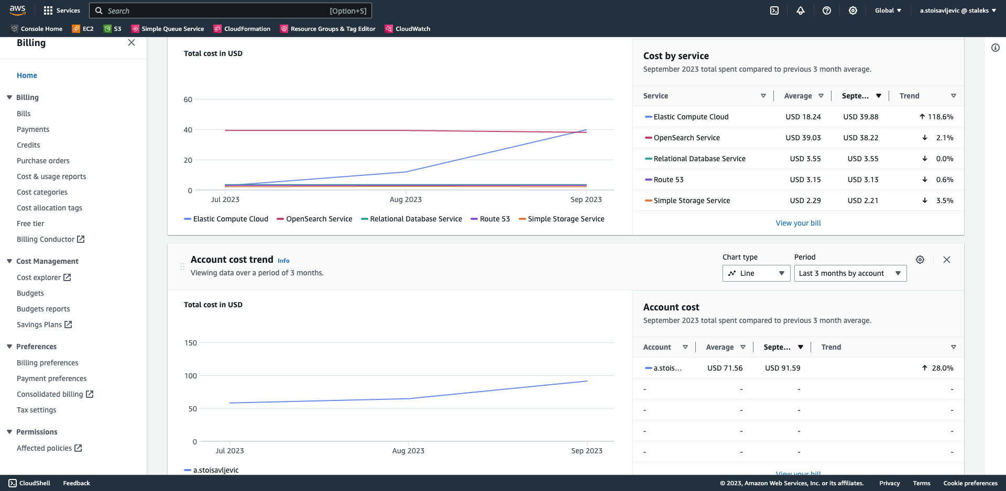
AWS Cost Anomaly Detection
“Elevate The Cloud Game” - Stoisavljević Aleksandar @ 2023

Slide 95
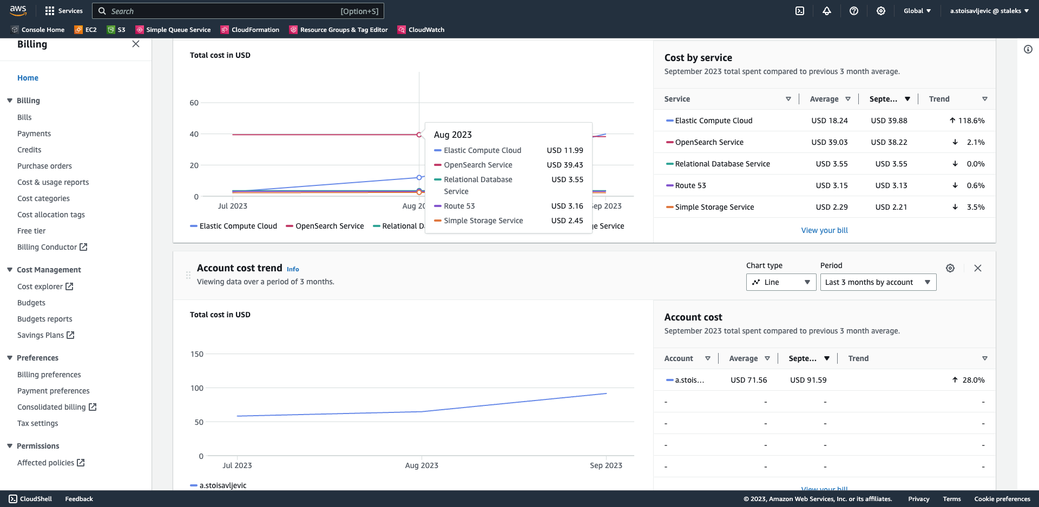
AWS Cost Anomaly Detection
“Elevate The Cloud Game” - Stoisavljević Aleksandar @ 2023

Slide 96
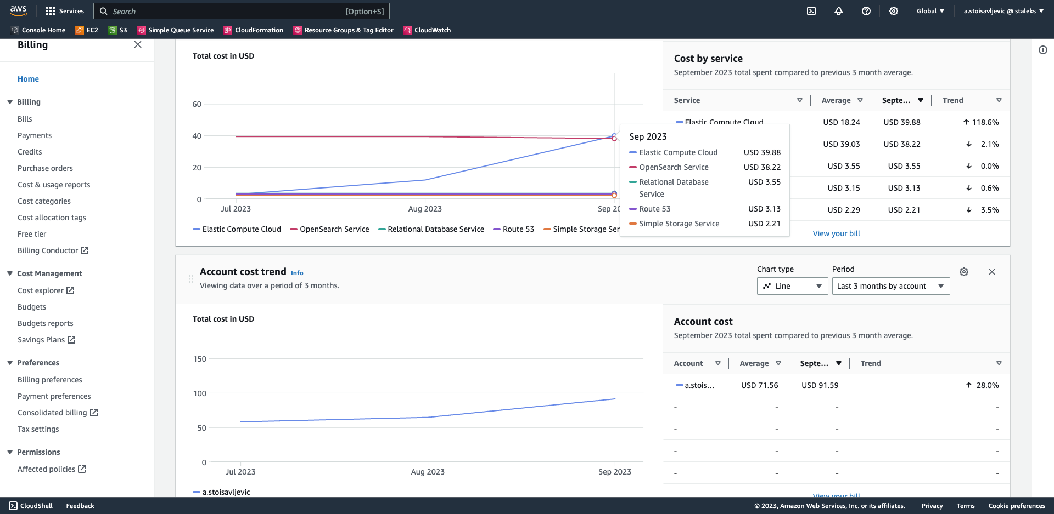
AWS Cost Anomaly Detection
“Elevate The Cloud Game” - Stoisavljević Aleksandar @ 2023

Slide 97
Other tools
that I didn’t have time to address :(
AWS S3 Analytics (AWS S3 Storage Lens)
AWS CloudWatch
AWS CloudTrail
“Elevate The Cloud Game” - Stoisavljević Aleksandar @ 2023

Slide 98
References:
AWS Well-Architected Framework Cost Optimization Pillar
https://docs.aws.amazon.com/pdfs/wellarchitected/latest/cost-optimization-pillar/wellarchitected-cost-optimization-pillar.pdf
The well-architected way - AWS re:Invent 2022
https://www.youtube.com/watch?v=nOKvA8HykW8
Cost Optimization on AWS
https://www.youtube.com/watch?v=nNS2VBLH6ks
“Elevate The Cloud Game” - Stoisavljević Aleksandar @ 2023

Slide 99
Conclusion & key takeaways
“Elevate The Cloud Game” - Stoisavljević Aleksandar @ 2023

Slide 100
Conclusion & key takeaways
Like everything in a life - this requires some trade-offs.
optimize for speed-to-market
VS.
optimize for cost
Don’t miss to tag everything. It will save your nerves later.
Measure the base line.
Monitor as much as you can.
Alert on exceptions.
Establish responsibility model.
If you are already addressing the cost, then take time to properly address the issue.
“Elevate The Cloud Game” - Stoisavljević Aleksandar @ 2023

Slide 101
Thank You
astoisavljevic
@staleksit
“Elevate The Cloud Game” - Stoisavljević Aleksandar @ 2023

Slide 102
Questions & Answers
“Elevate The Cloud Game” - Stoisavljević Aleksandar @ 2023

Slide 103
Thank You
astoisavljevic
@staleksit
“Elevate The Cloud Game” - Stoisavljević Aleksandar @ 2023

